Slide 1
Chapter 4
Science, Mathematics, and Computer Science Courses
Mathematics

Slide 2
Time Spent on Mathematics Instruction in Elementary Grades

Slide 3
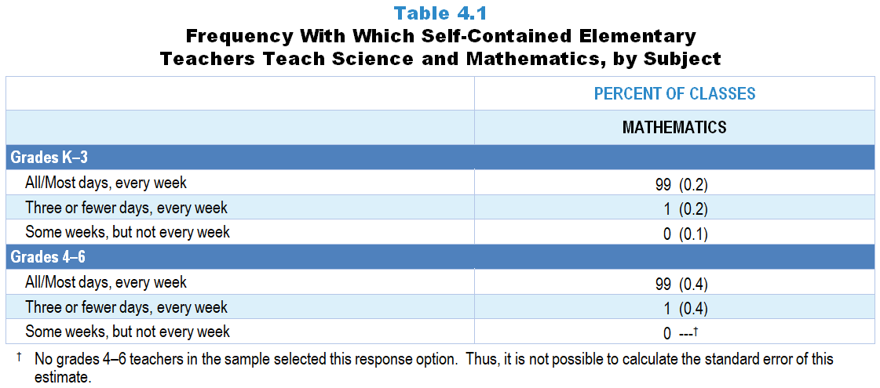
Original Data for Slide 4
(not for presentation)
Notes:
The mathematics portion of Table 4.1, p. 77 in Technical Report
This slide shows data from an individual item.
Mathematics Teacher Questionnaire
Q5. Which best describes your mathematics teaching?
I teach mathematics all or most days, every week of the year.
I teach mathematics every week, but typically three or fewer days each week.
I teach mathematics some weeks, but typically not every week.
The numbers in parentheses are standard errors.
Findings Highlighted in Technical Report
“Self-contained elementary teachers were asked how often they teach mathematics and/‌or science. As can be seen in Table 4.1, mathematics is taught in virtually all classes on most or all school days in both grades K–3 and 4–6. In contrast, science is taught less frequently, with only 17 percent of grades K–3 classes and 35 percent of grades 4–6 classes receiving science instruction all or most days, every week of the school year. Many elementary classes receive science instruction only a few days a week or during some weeks of the year.”

Slide 4
Frequency with Which Self-Contained Elementary Classes Receive Mathematics Instruction
Notes:
Includes only teachers assigned to teach multiple subjects to a single class of students grades K–6.

Slide 5
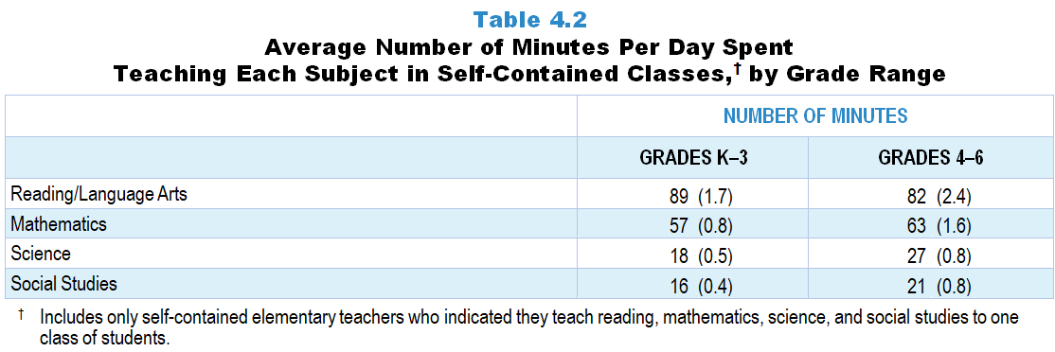
Original Data for Slide 6
(not for presentation)
Notes:
Table 4.2, p. 78 in Technical Report
This slide shows data from individual items found on both the Science Teacher Questionnaire and Mathematics Teacher Questionnaire.
Science Teacher Questionnaire
Q6. In a typical week, how many days do you teach lessons on each of the following subjects and how many minutes per week are spent on each subject?
Mathematics _____ _____
Science _____ _____
Social Studies _____ _____
Reading/Language Arts _____ _____
Q7. In a typical year, how many weeks do you teach lessons on each of the following subjects and how many minutes per week are spent on each subject?
Mathematics _____ _____
Science _____ _____
Social Studies _____ _____
Reading/Language Arts _____ _____
Mathematics Teacher Questionnaire
Q7. In a typical week, how many days do you teach lessons on each of the following subjects and how many minutes per week are spent on each subject?
Mathematics _____ _____
Science _____ _____
Social Studies _____ _____
Reading/Language Arts _____ _____
Q8. In a typical year, how many weeks do you teach lessons on each of the following subjects and how many minutes per week are spent on each subject?
Mathematics _____ _____
Science _____ _____
Social Studies _____ _____
Reading/Language Arts _____ _____
The numbers in parentheses are standard errors.
Findings Highlighted in Technical Report
“The survey also asked the approximate number of minutes typically spent teaching mathematics, science, social studies, and reading/‌language arts in self-contained classes. The average number of minutes per day typically spent on instruction in each subject in grades K–3 and 4–6 is shown in Table 4.2; to facilitate comparisons among the subject areas, only teachers who teach all four of these subjects to one class of students were included in this analysis. In 2018, grades K–3 self-contained classes spent an average of 89 minutes per day on reading instruction and 57 minutes on mathematics instruction, compared to only 18 minutes on science and 16 minutes on social studies instruction. The pattern in grades 4–6 is similar, with 82 minutes per day devoted to reading, 63 minutes to mathematics, 27 minutes to science, and 21 minutes to social studies instruction.”

Slide 6
Average Number of Minutes Per Day Spent Teaching Each Subject in Self-Contained Classes
Notes:
Only teachers who indicated they teach reading/language arts, mathematics, science, and social studies to one class of students were included in these analyses.

Slide 7
Mathematics Course Offerings

Slide 8
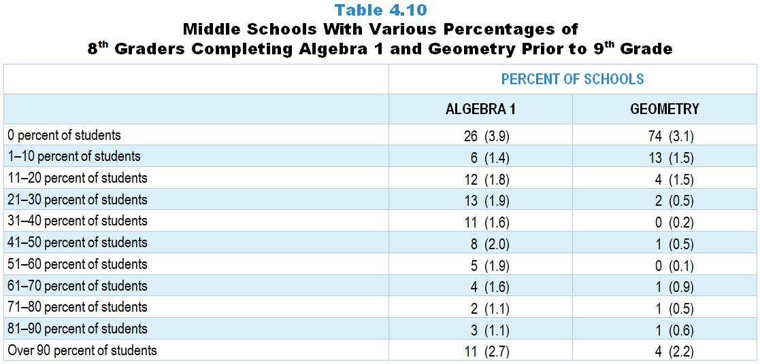
Original Data for Slide 9
(not for presentation)
Notes:
Table 4.10, p. 82 in Technical Report
This slide shows data derived from:
Mathematics Program Questionnaire
Q6. [Presented only to schools that include grade 8]Approximately how many of this year’s 8th grade students will have completed Algebra 1 or its equivalent (for example: Integrated Math 1) prior to 9th grade? [Enter your response as a whole number (for example: 15).] _____
Q7. [Presented only to schools that include grade 8]Approximately how many of this year’s 8th grade students will have completed Geometry or its equivalent (for example Integrated Math 2) prior to 9th grade? [Enter your response as a whole number (for example: 15).] _____
The numbers in parentheses are standard errors.
Findings Highlighted in Technical Report
“In mathematics, middle schools were asked how many 8th grade students would complete Algebra 1 and Geometry prior to 9th grade. As can be seen in Table 4.10, about three-fourths of middle schools have some students completing Algebra 1, and about one-fourth have students completing Geometry. Approximately a quarter of middle schools have 51 percent or more of their students completing Algebra 1; in schools that offer Geometry, only a small percentage of students typically complete the course prior to 9th grade.”

Slide 9
Middle Schools With Percentages of 8th Grade Students Completing Algebra 1 and Geometry Prior to 9th Grade

Slide 10
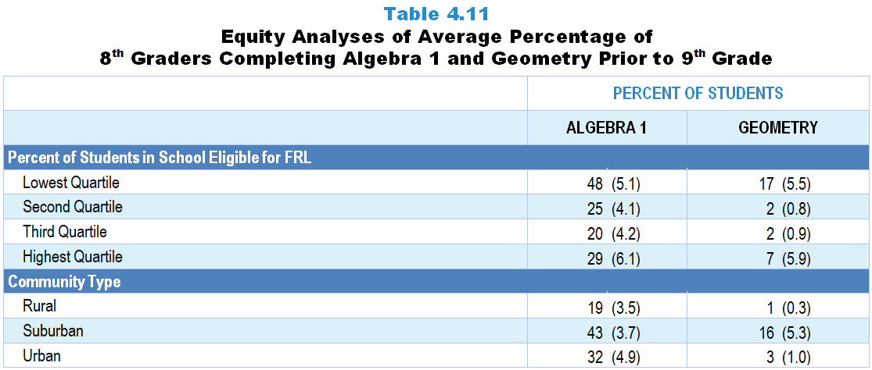
Original Data for Slides 11–12
(not for presentation)
Notes:
Table 4.11, p. 83 in Technical Report
This slide shows data derived from:
Mathematics Program Questionnaire
Q6. [Presented only to schools that include grade 8]Approximately how many of this year’s 8th grade students will have completed Algebra 1 or its equivalent (for example: Integrated Math 1) prior to 9th grade? [Enter your response as a whole number (for example: 15).] _____
Q7. [Presented only to schools that include grade 8]Approximately how many of this year’s 8th grade students will have completed Geometry or its equivalent (for example Integrated Math 2) prior to 9th grade? [Enter your response as a whole number (for example: 15).] _____
Chapters 2–7 in the technical report provide data on several key indicators, disaggregated by one or more equity factors: the prior achievement level of students in the class, the percentage of non-Asian minority students in the class, the percentage of students in the school eligible for free/reduced-price lunch (FRL), school size, community type, and region. For FRL, each school was classified into one of four categories (defined as quartiles) based on the proportion of students eligible for FRL. Similarly, each randomly selected class was classified into one of the four categories based on the proportion of students in the class identified as non-Asian minorities. Note: Since the publication of the technical report, the term “Non-Asian Minority” has been changed to “Race/Ethnic Groups Historically Underrepresented in STEM.” This updated language is used in the slides provided for presentation.
The numbers in parentheses are standard errors.
Findings Highlighted in Technical Report
“The data also show that students in high-poverty schools are less likely than students in low-poverty schools to complete either of these courses prior to 9th grade (see Table 4.11). In addition, a smaller proportion of students in rural middle schools complete Algebra 1 than in suburban and urban middle schools, and a smaller proportion of students in rural and urban middle schools complete Geometry than in suburban middle schools.”

Slide 11
8th Grade Students Completing Algebra 1 and Geometry Prior to 9th Grade, by Percentage of Students in School Eligible for FRL
Notes:
Slide shows the composite scores by quartile of percent free/reduced-price lunch eligible students in the school.

Slide 12
8th Grade Students Completing Algebra 1 and Geometry Prior to 9th Grade, by Community Type

Slide 13
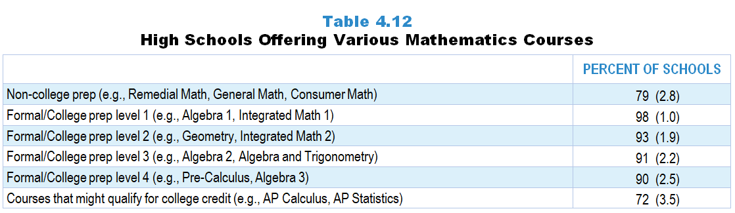
Original Data for Slide 14
(not for presentation)
Notes:
Table 4.12, p. 83 in Technical Report
This slide shows data from an individual item.
Mathematics Program Questionnaire
Q10. Is your school offering any courses in each of the following categories this year for students in grades 9–12? [Select one on each row.] (response options Yes, No)
Non-college prep mathematics courses
Example courses: Developmental Math; High School Arithmetic; Remedial Math; General Math; Vocational Math; Consumer Math; Basic Math; Business Math; Career Math; Practical Math; Essential Math; Pre-Algebra; Introductory Algebra; Algebra 1 Part 1; Algebra 1A; Math A; Basic Geometry; Informal Geometry; Practical Geometry
Formal/College prep mathematics level 1 courses
Example courses: Algebra 1; Integrated Math 1; Unified Math I; Algebra 1 Part 2; Algebra 1B; Math B
Formal/College prep mathematics level 2 courses
Example courses: Geometry; Plane Geometry; Solid Geometry; Integrated Math 2; Unified Math II; Math C
Formal/College prep mathematics level 3 courses
Example courses: Algebra 2; Intermediate Algebra; Algebra and Trigonometry; Advanced Algebra; Integrated Math 3; Unified Math III
Formal/College prep mathematics level 4 courses
Example courses: Algebra 3; Trigonometry; Pre-Calculus; Analytic/Advanced Geometry; Elementary Functions; Integrated Math 4, Unified Math IV; Calculus (not including college level/AP); any other College Prep Senior Math with Algebra 2 as a prerequisite
Mathematics courses that might qualify for college credit
Example courses: Advanced Placement Calculus (AB, BC); Advanced Placement Statistics; IB Mathematics Standard Level; IB Mathematics Higher Level; concurrent college and high school credit/dual enrollment
The numbers in parentheses are standard errors.
Findings Highlighted in Technical Report
“Table 4.12 shows mathematics courses offered at the high school level. Nearly all high schools offer a 1st year formal/‌college prep mathematics course such as Algebra 1 or Integrated Math 1. The vast majority of high schools also offer a second, third, and fourth year of formal mathematics. Almost three-fourths of high schools offer mathematics courses that might qualify for college credit such as AP Calculus or AP Statistics.”

Slide 14
High Schools Offering Various Mathematics Courses

Slide 15
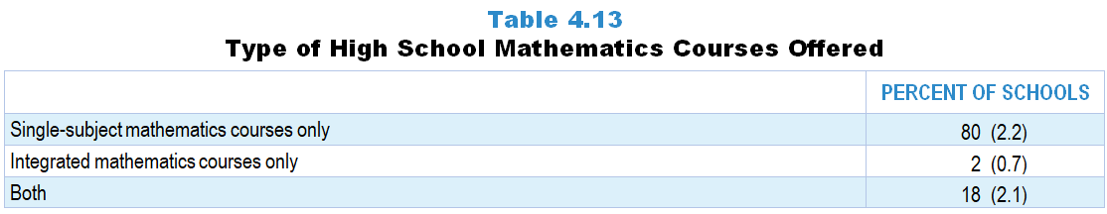
Original Data for Slide 16
(not for presentation)
Notes:
Table 4.13, p. 83 in Technical Report
This slide shows data derived from:
Mathematics Program Questionnaire
Q9. What types of mathematics courses are offered to grades 9–12 students in your school this year? [Select all that apply.]
Single-subject mathematics courses (for example: Algebra, Geometry)
Integrated mathematics courses
The numbers in parentheses are standard errors.
Findings Highlighted in Technical Report
“Almost all high schools (98 percent) offer single-discipline mathematics courses, with 80 percent offering only these types of courses (see Table 4.13). Close to 1 in 5 high schools also offer coordinated or integrated mathematics courses; only 2 percent of high schools offer coordinated or integrated mathematics courses exclusively.”

Slide 16
Type of High School Mathematics Courses Offered

Slide 17
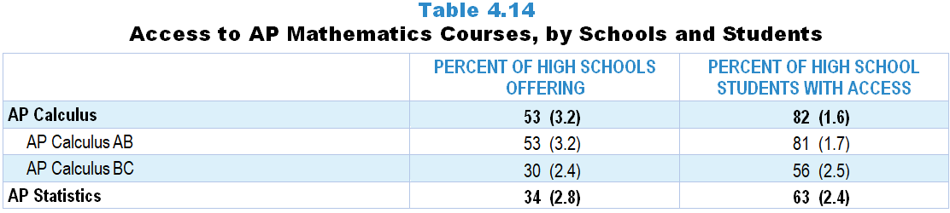
Original Data for Slide 18
(not for presentation)
Notes:
Table 4.14, p. 84 in Technical Report
This slide shows data derived from:
Mathematics Program Questionnaire
Q15. Is each of the following mathematics courses offered in this school?
(Response Options: [1] Available (Response Options: Yes, No) ;
[2] Where Offered (Response Options: At this school, Elsewhere (offsite or online)) ;
[3] When Offered (Response Options: This year, Not this year, but in alternating years)
AP Calculus AB
AP Calculus BC
AP Statistics
IB Mathematical studies standard level
IB Mathematics standard level
IB Mathematics higher level
IB Further mathematics standard level
The numbers in parentheses are standard errors.
Findings Highlighted in Technical Report
“As can be seen in Table 4.14, just over half of high schools offer AP Calculus, typically AP Calculus AB. AP Calculus BC and AP Statistics are each offered by about one-third of high schools. As was the case in science, the percentage of grades 9–12 students with access to each course is substantially greater than the percentage of schools offering it, indicating that AP mathematics courses are more likely to be offered in larger schools.”

Slide 18
Access to AP Mathematics Courses

Slide 19
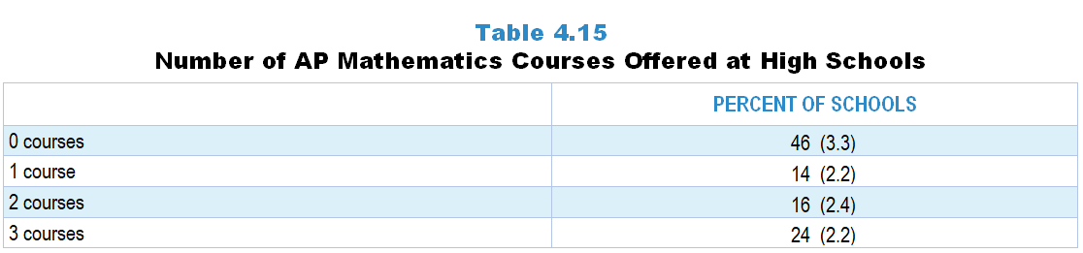
Original Data for Slide 20
(not for presentation)
Notes:
Table 4.15, p. 84 in Technical Report
This slide shows data derived from:
Mathematics Program Questionnaire
Q15. Is each of the following mathematics courses offered in this school? [Select one on each row.]
(Response Options: [1] Available (Response Options: Yes, No) ;
[2] Where Offered (Response Options: At this school, Elsewhere (offsite or online)) ;
[3] When Offered (Response Options: This year, Not this year, but in alternating years)
AP Calculus AB
AP Calculus BC
AP Statistics
IB Mathematical studies standard level
IB Mathematics standard level
IB Mathematics higher level
IB Further mathematics standard level
The numbers in parentheses are standard errors.
Findings Highlighted in Technical Report
“Although 46 percent of high schools do not offer any AP mathematics courses, 24 percent offer all three AP mathematics courses currently available (see Table 4.15). Fourteen percent of high schools offer one AP mathematics course, and 16 percent offer two different AP mathematics courses.”

Slide 20
Number of AP Mathematics Courses Offered at High Schools
Notes:
Only schools that responded about each AP mathematics course are included in this analysis

Slide 21
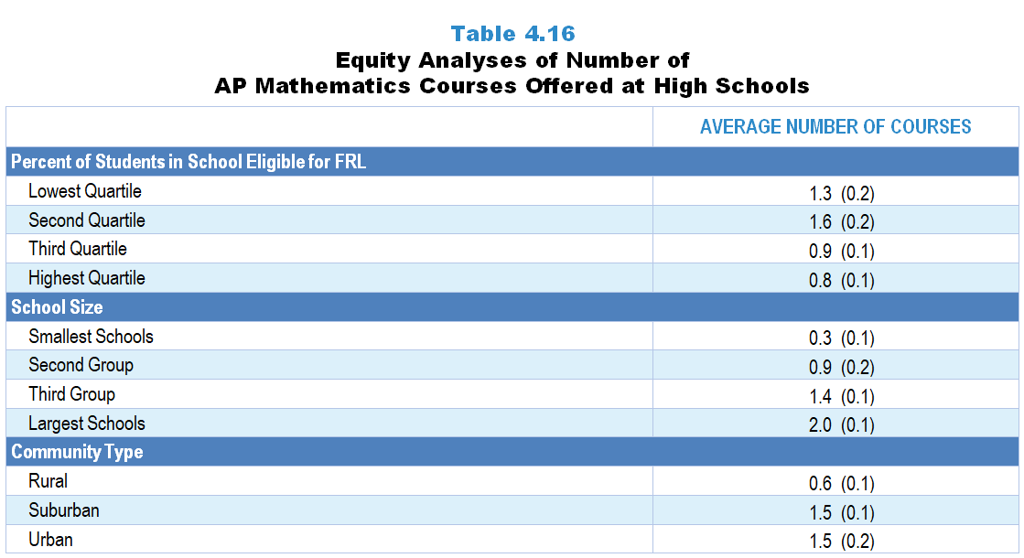
Original Data for Slides 22–24
(not for presentation)
Notes:
Table 4.16, p. 85 in Technical Report
This slide shows data derived from:
Mathematics Program Questionnaire
Q15_1. Is each of the following mathematics courses offered in this school? [Select one on each row.]
(Response Options: [1] Available (Response Options: Yes, No) ;
[2] Where Offered (Response Options: At this school, Elsewhere (offsite or online)) ;
[3] When Offered (Response Options: This year, Not this year, but in alternating years)
AP Calculus AB
AP Calculus BC
AP Statistics
IB Mathematical studies standard level
IB Mathematics standard level
IB Mathematics higher level
IB Further mathematics standard level
The numbers in parentheses are standard errors.
Chapters 2–7 in the technical report provide data on several key indicators, disaggregated by one or more equity factors: the prior achievement level of students in the class, the percentage of students from race/ethnicity groups historically underrepresented in STEM in the class, the percentage of students in the school eligible for free/reduced-price lunch (FRL), school size, community type, and region. For FRL, each school was classified into one of four categories (defined as quartiles) based on the proportion of students eligible for FRL. Similarly, each randomly selected class was classified into one of the four categories based on the proportion of students from race/ethnicity groups historically underrepresented in STEM in the class.
Findings Highlighted in Technical Report
“The data on the number of AP mathematics courses offered by various equity factors follow the same pattern as in science. As can be seen in Table 4.16, small schools tend to offer fewer AP mathematics courses than large schools, and suburban and urban schools offer more AP mathematics courses than rural schools. High-poverty schools offer fewer AP mathematics courses on average than low-poverty schools.”

Slide 22
Average Number of AP Mathematics Courses Offered at High Schools, by Percentage of Students Eligible for FRL
Notes:
Slide shows the composite scores by quartile of percent free/reduced-price lunch eligible students in the school.
Only schools that responded about each AP mathematics course are included in this analysis

Slide 23
Average Number of AP Mathematics Courses Offered at High Schools
Notes:
Only schools that responded about each AP mathematics course are included in this analysis

Slide 24
Average Number of AP Science Courses Offered at High Schools
Notes:
Only schools that responded about each AP mathematics course are included in this analysis

Slide 25
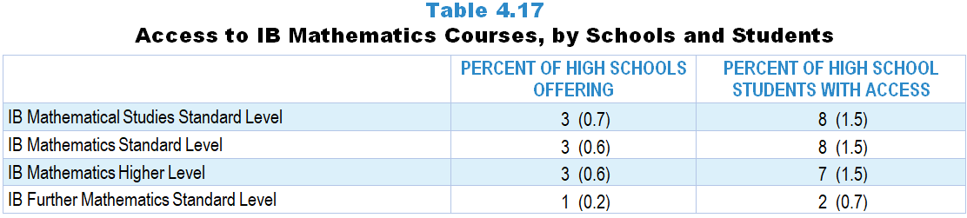
Original Data for Slide 26
(not for presentation)
Notes:
Table 4.17, p. 85 in Technical Report
This slide shows data derived from:
Mathematics Program Questionnaire
Q15_1. Is each of the following mathematics courses offered in this school? [Select one on each row.]
(Response Options: [1] Available (Response Options: Yes, No) ;
[2] Where Offered (Response Options: At this school, Elsewhere (offsite or online)) ;
[3] When Offered (Response Options: This year, Not this year, but in alternating years)
AP Calculus AB
AP Calculus BC
AP Statistics
IB Mathematical studies standard level
IB Mathematics standard level
IB Mathematics higher level
IB Further mathematics standard level
The numbers in parentheses are standard errors.
Findings Highlighted in Technical Report
“The survey also asked if high schools offer IB mathematics courses. As schools tend to offer IB courses in all disciplines or not at all, it is not surprising that the data for mathematics (see Table 4.17) mirror those for science.”

Slide 26
Access to IB Mathematics Courses

Slide 27
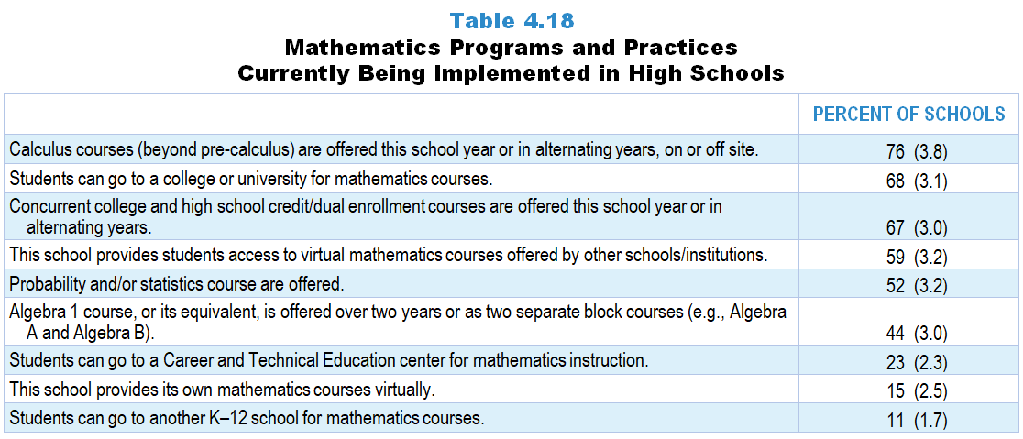
Original Data for Slides 28–29
(not for presentation)
Notes:
Table 4.18, p. 86 in Technical Report
This slide shows data from individual items.
Mathematics Program Questionnaire
Q3. [Presented only to schools that include any grades 9–12]
Indicate whether each of the following programs and/or practices is currently being implemented in your school. [Select one on each row.]
(Response Options: Yes, No)
Algebra 1 course, or its equivalent, offered over two years or as two separate block courses (for example: Algebra A and Algebra B, or Integrated Math A and Integrated Math B).
Calculus courses (beyond pre-Calculus) offered this school year or in alternating years, on or off site.
Students can go to a Career and Technical Education (CTE) center for mathematics instruction.
This school provides students access to virtual mathematics courses offered by other schools/institutions (for example: online, videoconference).
This school provides its own mathematics courses virtually (for example: online, videoconference).
Students can go to another K–12 school for mathematics courses.
Students can go to a college or university for mathematics courses.
Q13. Does your school offer each of the following types of mathematics courses that might qualify for college credit? (Include both courses that are offered every year and those offered in alternating years.) [Select one on each row.] (Response Options: Yes, No)
Advanced Placement (AP) mathematics courses
International Baccalaureate (IB) mathematics courses
Concurrent college and high school credit/dual enrollment mathematics courses
The numbers in parentheses are standard errors.
Findings Highlighted in Technical Report
“The mathematics program questionnaire also asked about a number of specific course-taking opportunities provided to students. As can be seen in Table 4.18, 76 percent of high schools offer some form of calculus course, including AP and non-AP courses, and 52 percent offer some form of probability and/‌or statistics course. More than 2 in 5 high schools offer Algebra 1 as a two-course sequence (e.g., Algebra A and Algebra B). Students going to a college or university for courses, earning college credit through dual enrollment, or taking virtual courses are more common practices in mathematics (59–68 percent of high schools) than in science (41–54 percent of high schools).”

Slide 28
Mathematics Programs and Practices Currently Being Implemented at High Schools

Slide 29
Mathematics Programs and Practices Currently Being Implemented at High Schools

Slide 30
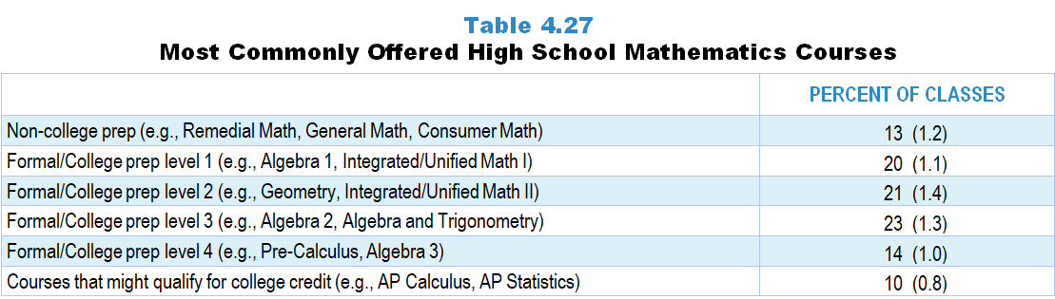
Original Data for Slide 31
(not for presentation)
Notes:
Table 4.27, p. 90 in Technical Report
This slide shows data derived from:
Mathematics Teacher Questionnaire
Q10. [Presented to non-self contained teachers only]
For each mathematics class you currently teach, select the course type and enter the number of students enrolled. Enter the classes in the order that you teach them. For teachers on an alternating day block schedule, please order your classes starting with the first class you teach this week.
Course type list
Mathematics (Grades K‒5)
Remedial Mathematics 6
Regular Mathematics 6
Accelerated/Pre-Algebra Mathematics 6
Remedial Mathematics 7
Regular Mathematics 7
Accelerated Mathematics 7
Remedial Mathematics 8
Regular Mathematics 8
Accelerated Mathematics 8
Algebra 1, Grade 7 or 8
Non-college prep mathematics course (Grades 9‒12)
Formal/College prep mathematics level 1 course (Grades 9‒12)
Formal/College prep mathematics level 2 course (Grades 9‒12)
Formal/College prep mathematics level 3 course (Grades 9‒12)
Formal/College prep mathematics level 4 course (Grades 9‒12)
Mathematics course that might qualify for college credit (Grades 9‒12)
The numbers in parentheses are standard errors.
Findings Highlighted in Technical Report
“In mathematics, formal/‌college prep levels 1, 2, and 3 courses each account for 20 percent or more of grades 9­–12 mathematics classes (see Table 4.27). Formal level 4 courses make up 14 percent of the classes, non-college prep mathematics 13 percent, and courses that might qualify for college credit account for 10 percent of classes.”

Slide 31
Most Commonly Offered High School Mathematics Courses
Notes:
Note: Examples of courses in groups are as follows:
Non-college prep mathematics courses
Developmental Math; High School Arithmetic; Remedial Math; General Math; Vocational Math; Consumer Math; Basic Math; Business Math; Career Math; Practical Math; Essential Math; Pre-Algebra; Introductory Algebra; Algebra 1 Part 1; Algebra 1A; Math A; Basic Geometry; Informal Geometry; Practical Geometry
Formal/College prep mathematics level 1 courses
Algebra 1; Math 1; Integrated/Unified Math I; Algebra 1 Part 2; Algebra 1B; Math B
Formal/College prep mathematics level 2 courses
Geometry; Plane Geometry; Solid Geometry; Math 2; Integrated/Unified Math II; Math C
Formal/College prep mathematics level 3 courses
Algebra 2; Intermediate Algebra; Algebra and Trigonometry; Advanced Algebra; Math 3; Integrated/Unified Math III
Formal/College prep mathematics level 4 courses
Algebra 3; Trigonometry; Pre-Calculus; Analytic/Advanced Geometry; Elementary Functions; Integrated Math 4; Unified Math IV; Calculus (not including college level/AP); any other college prep senior math with Algebra 2/Math 3 as a prerequisite
Mathematics courses that might qualify for college credit
Advanced Placement Calculus (AB, BC); Advanced Placement Statistics; IB Mathematics Standard Level; IB Mathematics Higher Level; concurrent college and high school credit/dual enrollment

Slide 32
Other Characteristics of Mathematics Classes

Slide 33
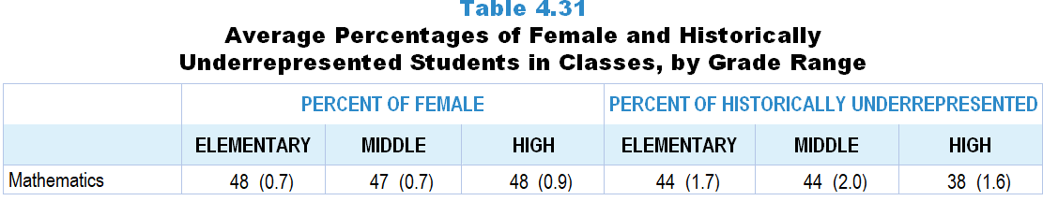
Original Data for Slide 34
(not for presentation)
Notes:
The mathematics portion of Table 4.31, p. 93 in Technical Report
This slide shows data derived from:
Mathematics Teacher Questionnaire
Q30. For the number of students in this class, indicate the number of males and females in each of the following categories of race/ethnicity.
American Indian or Alaskan Native _____ _____
Asian _____ _____
Black or African American _____ _____
Hispanic/Latino _____ _____
Native Hawaiian or Other Pacific Islander _____ _____
White _____ _____
Two or more races _____ _____
The numbers in parentheses are standard errors.
Findings Highlighted in Technical Report
“Table 4.31 shows the percentages of female students and students from race/‌ethnicity groups historically underrepresented in STEM in classes in the different grade bands. Elementary and middle school data mirror those of students in the nation, as students typically are required to take science and mathematics at each grade level. In high school, where students are generally not required to take each subject every year, the data show that historically underrepresented students are less likely to take science and mathematics classes. In high school computer science classes, only about a quarter of students are female or from a historically underrepresented race/‌ethnicity group.”

Slide 34
Average Percentages of Female and Historically Underrepresented Students in Classes
Notes:
Note: Historically Underrepresented Students includes American Indian or Alaskan Native, Black or African American, Hispanic or Latino, or Native Hawaiian or Other Pacific Islander students.

Slide 35
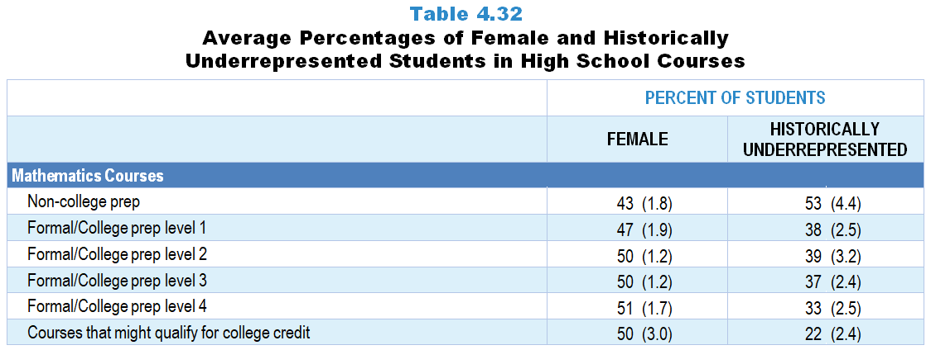
Original Data for Slides 36–37
(not for presentation)
Notes:
The mathematics portion of Table 4.32, p. 94 in Technical Report
This slide shows data derived from:
Mathematics Teacher Questionnaire
Q10. For each mathematics class you currently teach, select the course type and enter the number of students enrolled. Enter the classes in the order that you teach them. For teachers on an alternating day block schedule, please order your classes starting with the first class you teach this week.
Course type list
Mathematics (Grades K‒5)
Remedial Mathematics 6
Regular Mathematics 6
Accelerated/Pre-Algebra Mathematics 6
Remedial Mathematics 7
Regular Mathematics 7
Accelerated Mathematics 7
Remedial Mathematics 8
Regular Mathematics 8
Accelerated Mathematics 8
Algebra 1, Grade 7 or 8
Non-college prep mathematics course (Grades 9‒12)
Formal/College prep mathematics level 1 course (Grades 9‒12)
Formal/College prep mathematics level 2 course (Grades 9‒12)
Formal/College prep mathematics level 3 course (Grades 9‒12)
Formal/College prep mathematics level 4 course (Grades 9‒12)
Mathematics course that might qualify for college credit (Grades 9‒12)
Q30. For the number of students in this class, indicate the number of males and females in each of the following categories of race/ethnicity.
American Indian or Alaskan Native _____ _____
Asian _____ _____
Black or African American _____ _____
Hispanic/Latino _____ _____
Native Hawaiian or Other Pacific Islander _____ _____
White _____ _____
Two or more races _____ _____
The numbers in parentheses are standard errors.
Findings Highlighted in Technical Report
“A pattern of decreasing enrollment of students from race/‌ethnicity groups historically underrepresented in STEM is seen in the class composition data across the progression of high school science and mathematics courses (see Table 4.32). For example, students from these groups make up 43 percent of students in non-college prep science classes and 35 percent of students in 1st year biology classes, compared to only 27 percent in advanced science classes. In mathematics, 38 percent of students in formal/college prep level 1 classes are from race/‌ethnicity groups historically underrepresented in STEM, compared to only 22 percent of students in classes that might qualify for college credit. In computer science, students from these groups make up 30 percent of students in introductory classes and 23 percent of students in courses that might qualify for college credit. In terms of gender, high school science and mathematics courses tend to have classes that are evenly split between male and female students on average. Exceptions are non-college prep science and mathematics classes and 1st year physics classes, which have smaller percentages of female students.”

Slide 36
Average Percentages of Female Students in High School Mathematics Courses

Slide 37
Average Percentage of Historically Underrepresented Students in High School Mathematics Courses
Notes:
Historically Underrepresented Students includes American Indian or Alaskan Native, Black or African American, Hispanic or Latino, or Native Hawaiian or Other Pacific Islander students.

Slide 38
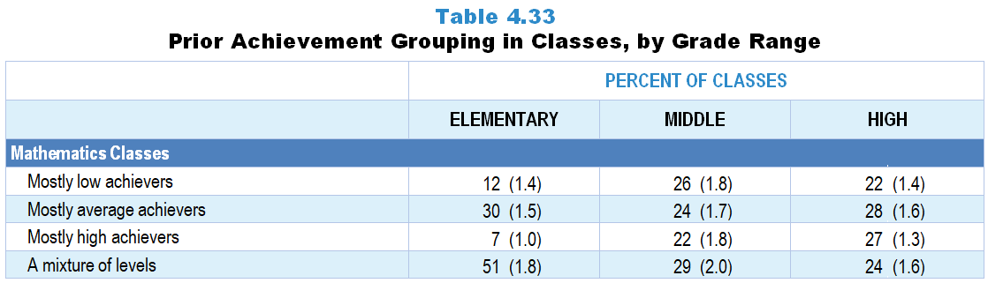
Original Data for Slide 39
(not for presentation)
Notes:
The mathematics portion of Table 4.33, p. 95 in Technical Report
This slide shows data from an individual item.
Mathematics Teacher Questionnaire
Q31. Which of the following best describes the prior mathematics achievement levels of the students in this class relative to other students in this school?
Mostly low achievers
Mostly average achievers
Mostly high achievers
A mixture of levels
The numbers in parentheses are standard errors.
Findings Highlighted in Technical Report
“Teachers were asked to indicate the prior achievement level of students in the selected class relative to other students in the school. At the elementary level, 41 percent of science and 51 percent of mathematics classes are heterogeneous in terms of prior achievement; most of the remaining classes are composed primarily of average-achieving students (see Table 4.33). Heterogeneous grouping is less common in middle school mathematics and in high school science and mathematics. However, 41 percent of high school computer science classes include students with a mixture of prior achievement levels. In contrast to science and mathematics, almost no computer science classes are composed of mostly low prior achievers.”

Slide 39
Prior Achievement Grouping in Mathematics Classes

Slide 40
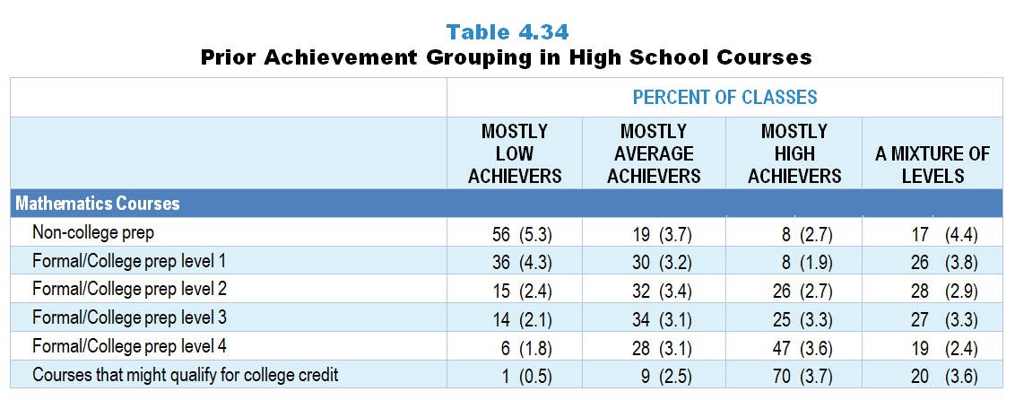
Original Data for Slides 41–42
(not for presentation)
Notes:
The mathematics portion of Table 4.34, p. 96 in Technical Report
This slide shows data derived from:
Mathematics Teacher Questionnaire
Q10. For each mathematics class you currently teach, select the course type and enter the number of students enrolled. Enter the classes in the order that you teach them. For teachers on an alternating day block schedule, please order your classes starting with the first class you teach this week.
Course type list
Mathematics (Grades K‒5)
Remedial Mathematics 6
Regular Mathematics 6
Accelerated/Pre-Algebra Mathematics 6
Remedial Mathematics 7
Regular Mathematics 7
Accelerated Mathematics 7
Remedial Mathematics 8
Regular Mathematics 8
Accelerated Mathematics 8
Algebra 1, Grade 7 or 8
Non-college prep mathematics course (Grades 9‒12)
Formal/College prep mathematics level 1 course (Grades 9‒12)
Formal/College prep mathematics level 2 course (Grades 9‒12)
Formal/College prep mathematics level 3 course (Grades 9‒12)
Formal/College prep mathematics level 4 course (Grades 9‒12)
Mathematics course that might qualify for college credit (Grades 9‒12)
Q31. Which of the following best describes the prior mathematics achievement levels of the students in this class relative to other students in this school?
Mostly low achievers
Mostly average achievers
Mostly high achievers
A mixture of levels
The numbers in parentheses are standard errors.
Findings Highlighted in Technical Report
“The percentage of science classes composed mostly of high prior achievers tends to increase across the traditional course sequence; for example, about 30 percent of 1st year biology and chemistry classes consist mostly of high prior achievers, compared to 42 percent of 1st year physics classes and 65 percent of advanced science classes (see Table 4.34). A similar trend occurs in mathematics, where few level 1, a quarter of level 2 and level 3, half of level 4, and a large majority of classes that might qualify for college credit are composed of mostly high prior achievers. In computer science, 24 percent of introductory computer science classes, 41 percent of specialized/‌elective classes, and 49 percent of classes that might qualify for college credit consist of mostly high prior achievers.”

Slide 41
Prior Achievement Grouping in High School Mathematics Classes

Slide 42
Prior Achievement Grouping in High School Mathematics Classes

Slide 43
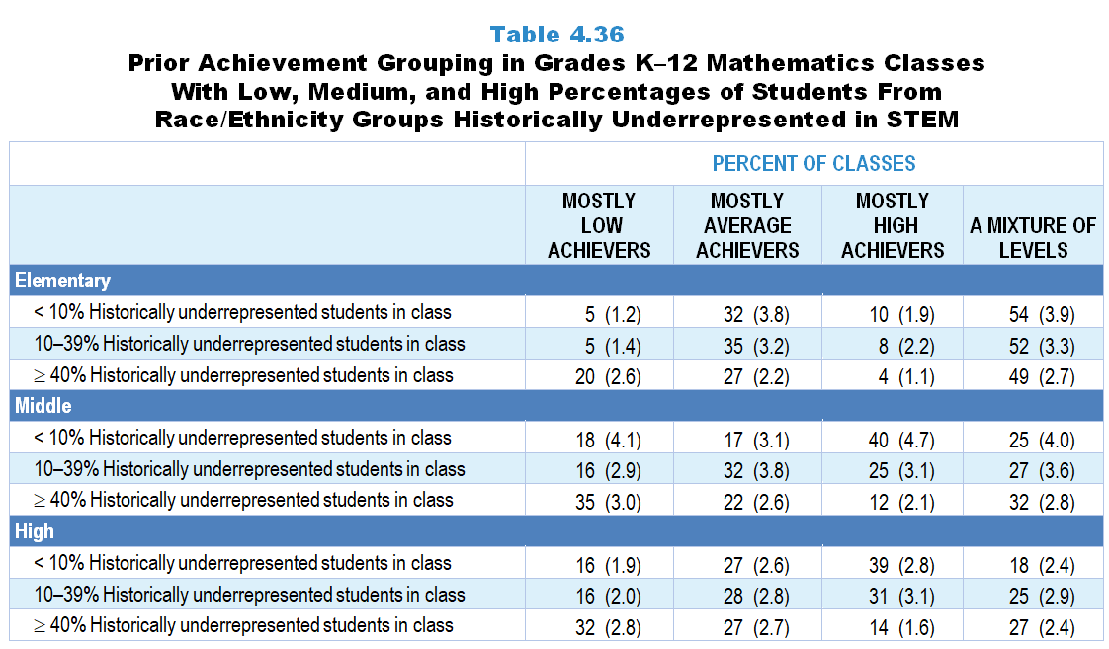
Original Data for Slide 44–46
(not for presentation)
Notes:
The mathematics portion of Table 4.36, p. 97 in Technical Report
This slide shows data derived from:
Mathematics Teacher Questionnaire
Q30. For the number of students in this class, indicate the number of males and females in each of the following categories of race/ethnicity.
American Indian or Alaskan Native _____ _____
Asian _____ _____
Black or African American _____ _____
Hispanic/Latino _____ _____
Native Hawaiian or Other Pacific Islander _____ _____
White _____ _____
Two or more races _____ _____
Q31. Which of the following best describes the prior mathematics achievement levels of the students in this class relative to other students in this school?
Mostly low achievers
Mostly average achievers
Mostly high achievers
A mixture of levels
The numbers in parentheses are standard errors.
Findings Highlighted in Technical Report
“Prior achievement grouping also varies by the percentage of students from race/‌ethnicity groups historically underrepresented in STEM in classes. Across all grade levels in both science (see Table 4.35) and mathematics (see Table 4.36), classes composed of 40 percent or more of students from race/‌ethnicity groups historically underrepresented in STEM are more likely to be classified as consisting of mostly low prior achievers than classes with smaller proportions of students from these groups. For example, 32 percent of high school mathematics classes with a high percentage of students from race/‌ethnicity groups historically underrepresented in STEM are classified as being composed mostly of low prior achievers, compared to 16 percent of classes with a low percentage of students from these groups. In high school computer science, classes composed of fewer than 10 percent of students from these groups are more likely to be classified as consisting of mostly high prior achievers than classes in which 40 percent or more of students are from these groups (see Table 4.37).”

Slide 44
Prior Achievement Grouping in Elementary Mathematics Classes
Notes:
Historically Underrepresented Students includes American Indian or Alaskan Native, Black or African American, Hispanic or Latino, or Native Hawaiian or Other Pacific Islander students.

Slide 45
Prior Achievement Grouping in Middle School Mathematics Classes
Notes:
Historically Underrepresented Students includes American Indian or Alaskan Native, Black or African American, Hispanic or Latino, or Native Hawaiian or Other Pacific Islander students.

Slide 46
Prior Achievement Grouping in High School Mathematics Classes
Notes:
Historically Underrepresented Students includes American Indian or Alaskan Native, Black or African American, Hispanic or Latino, or Native Hawaiian or Other Pacific Islander students.

