Slide 1
Chapter 7 Factors Affecting Instruction
Mathematics

Slide 2
School Programs and Practices

Slide 3
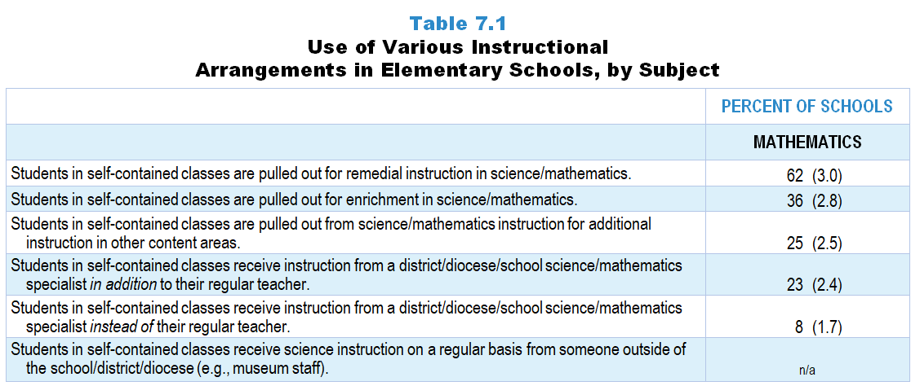
Original Data for Slide 4 (not for presentation)
Notes:
The mathematics portion of Table 7.1, p. 157 in Technical Report
This slide shows data from an individual item.
Mathematics Program Questionnaire
Q2. [Presented only to schools that include self-contained teachers] Indicate whether each of the following programs and/or practices is currently being implemented in your school. [Select one on each row.] (Response Options: Yes, No)
Students in self-contained classes receive mathematics instruction from a district/diocese/school mathematics specialist instead of their regular teacher.
Students in self-contained classes receive mathematics instruction from a district/diocese/school mathematics specialist in addition to their regular teacher.
Students in self-contained classes pulled out for remedial instruction in mathematics
Students in self-contained classes pulled out for enrichment in mathematics
Students in self-contained classes pulled out from mathematics instruction for additional instruction in other content areas
The numbers in parentheses are standard errors.
Findings Highlighted in Technical Report
“The designated school program representatives were given a list of programs and practices and asked to indicate whether each was being implemented in the school. These individuals were also asked about several instructional arrangements for students in elementary self-contained classrooms, such as whether they were pulled out for remediation or enrichment in science and mathematics and whether they received science and mathematics instruction from specialists instead of, or in addition to, their regular teacher. Table 7.1 shows the percentage of elementary schools indicating that each program or practice is in place.
The use of elementary science specialists, either in place of, or in addition to, the regular classroom teacher, is uncommon (7–15 percent of schools). Pull-out science instruction, whether for remediation or enrichment, is also quite rare (8–10 percent of schools). The picture is quite different in elementary school mathematics instruction. Students are pulled out for mathematics remediation in more than 60 percent of schools, and in just over one-third of schools, students are pulled out for mathematics enrichment. The prevalence of these practices may be due in part to the fact that mathematics is much more likely than science to be tested for accountability purposes. In addition, Title 1 funds are more likely to be targeted for remediation in mathematics and reading than in science.”

Slide 4
Use of Various Instructional Arrangements in Elementary Schools

Slide 5
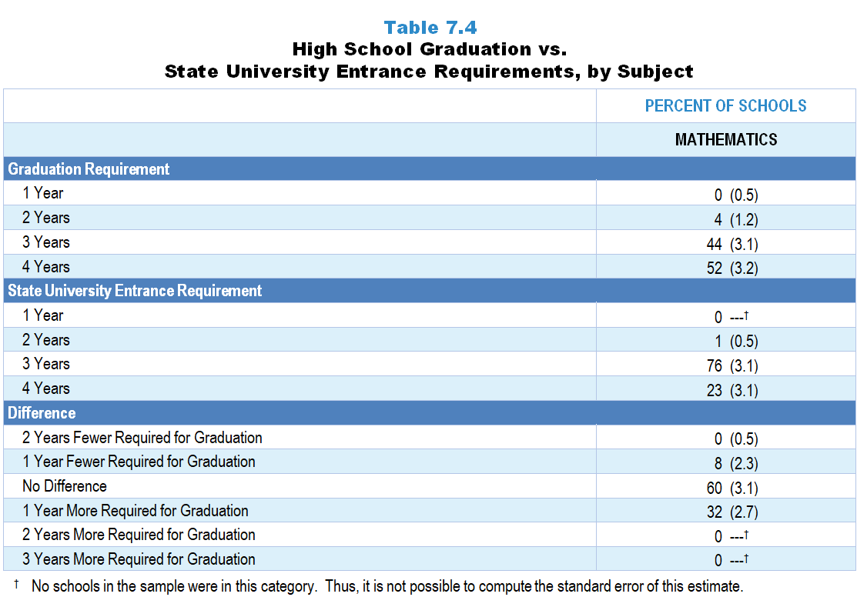
Original Data for Slides 6–7 (not for presentation)
Notes:
The mathematics portion of Table 7.4, p. 159 in Technical Report
This slide shows original and derived data from an individual item.
Mathematics Program Questionnaire
Q16. [Presented only to schools that include grade 12] In order to graduate from this high school, how many years of grades 9–12 mathematics are students required to take?
1 Year
2 Years
3 Years
4 Years
The numbers in parentheses are standard errors.
Findings Highlighted in Technical Report
“High school program representatives were asked how many years of science, mathematics, and computer science students are required to take in order to graduate. As can be seen in Table 7.4, the vast majority of high schools require at least three years of science and mathematics; more than half require four years of mathematics. For most schools, graduation requirements are just as demanding as state university entrance requirements. However, when there is a difference, graduation requirements tend to be more rigorous; 40 percent of high schools require more science and 32 percent require more mathematics courses for graduation than state universities do for entrance.”

Slide 6
High School Graduation vs. State University Entrance Mathematics Requirements

Slide 7
Difference Between High School Graduation and State University Entrance Mathematics Requirements

Slide 8
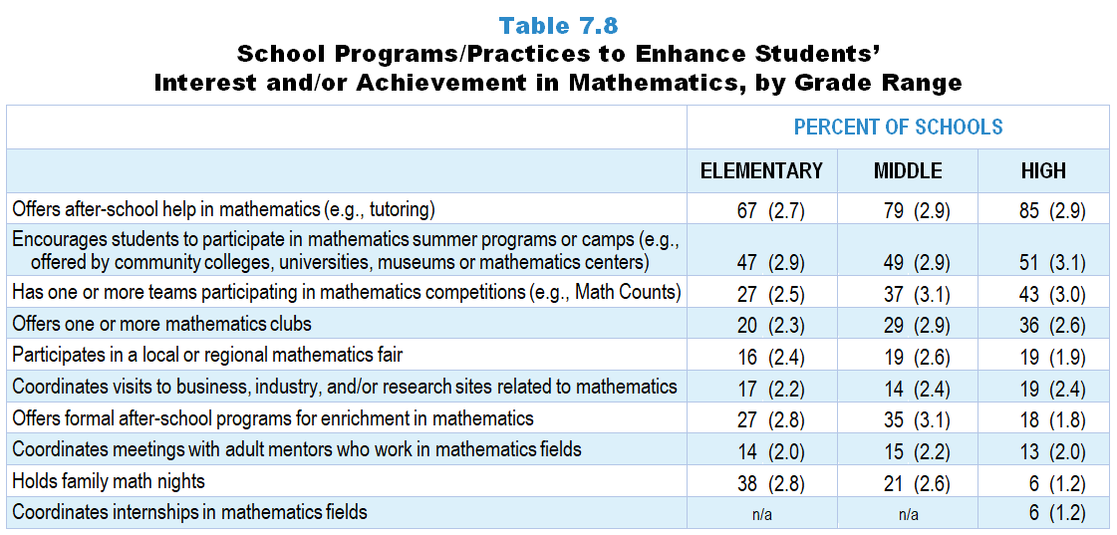
Original Data for Slides 9–14 (not for presentation)
Notes:
Table 7.8, p. 161 in Technical Report
This slide shows data from an individual item.
Mathematics Program Questionnaire
Q4. Indicate whether your school does each of the following to enhance students’ interest and/or achievement in mathematics. (Response Options: Yes, No)
Holds family math nights
Offers after-school help in mathematics (for example: tutoring)
Offers formal after-school programs for enrichment in mathematics
Offers one or more mathematics clubs
Participates in a local or regional mathematics fair
Has one or more teams participating in mathematics competitions (for example: Math Counts)
Encourages students to participate in mathematics summer programs or camps (for example: offered by community colleges, universities, museums or mathematics centers)
Coordinates visits to business, industry, and/or research sites related to mathematics
Coordinates meetings with adult mentors who work in mathematics fields
Coordinates internships in mathematics fields
The numbers in parentheses are standard errors.
Findings Highlighted in Technical Report
“Finally, program representatives were asked to indicate which of several practices their school employs to enhance student interest and/‌or achievement in science, mathematics, and computer science. The results are shown in Tables 7.7‒7.9. Especially in science, such programs tend to be more prevalent as grade range increases. For example, more than three-quarters of high schools offer after-school help in science and engineering, compared to about a third of elementary schools. Similarly, 47 percent of high schools have one or more teams participating in engineering competitions, whereas only 24 percent of elementary schools do. In mathematics, the percentage of schools offering school-based programs to enhance interest and achievement (apart from tutoring) is strikingly low. For example, only about one-third of high schools have mathematics clubs, and fewer than 20 percent of all schools participate in local or regional math fairs. Computer science enhancement programs are rare at all grade levels. With the exception of encouraging students to participate in computer science-based summer programs, the majority of all schools do not provide opportunities intended to promote interest and achievement in computer science. For example, 15 percent or fewer of all schools have teams participating in computer science competitions, coordinate internships in computer science, and participate in local or regional computer science fairs.”

Slide 9
Elementary School Programs/Practices to Enhance Students’ Interest/Achievement in Mathematics
Notes:
Note: Each grade-level chart is sorted independently; consequently items may appear in different orders.

Slide 10
Elementary School Programs/Practices to Enhance Students’ Interest/Achievement in Mathematics
Notes:
Note: Each grade-level chart is sorted independently; consequently items may appear in different orders.

Slide 11
Middle School Programs/Practices to Enhance Students’ Interest/Achievement in Mathematics
Notes:
Note: Each grade-level chart is sorted independently; consequently items may appear in different orders.

Slide 12
Middle School Programs/Practices to Enhance Students’ Interest/Achievement in Mathematics
Notes:
Note: Each grade-level chart is sorted independently; consequently items may appear in different orders.

Slide 13
High School Programs/Practices to Enhance Students’ Interest/Achievement in Mathematics
Notes:
Note: Each grade-level chart is sorted independently; consequently items may appear in different orders.

Slide 14
High School Programs/Practices to Enhance Students’ Interest/Achievement in Mathematics
Notes:
Note: Each grade-level chart is sorted independently; consequently items may appear in different orders.

Slide 15
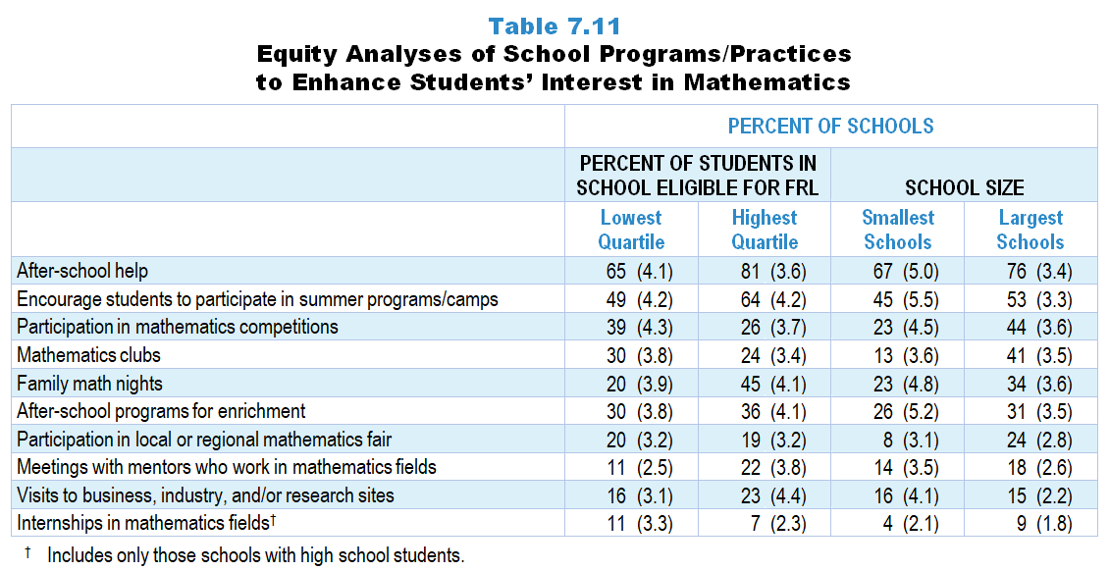
Original Data for Slides 16–19 (not for presentation)
Notes:
Table 7.11, p. 162 in Technical Report
This slide shows data from an individual item.
Mathematics Program Questionnaire
Q4. Indicate whether your school does each of the following to enhance students’ interest and/or achievement in mathematics. (Response Options: Yes, No)
Holds family math nights
Offers after-school help in mathematics (for example: tutoring)
Offers formal after-school programs for enrichment in mathematics
Offers one or more mathematics clubs
Participates in a local or regional mathematics fair
Has one or more teams participating in mathematics competitions (for example: Math Counts)
Encourages students to participate in mathematics summer programs or camps (for example: offered by community colleges, universities, museums or mathematics centers)
Coordinates visits to business, industry, and/or research sites related to mathematics
Coordinates meetings with adult mentors who work in mathematics fields
Coordinates internships in mathematics fields
The numbers in parentheses are standard errors.
Chapters 2–7 in the technical report provide data on several key indicators, disaggregated by one or more equity factors: the prior achievement level of students in the class, the percentage of students from race/ethnicity groups historically underrepresented in STEM in the class, the percentage of students in the school eligible for free/reduced-price lunch (FRL), school size, community type, and region. For FRL, each school was classified into one of four categories (defined as quartiles) based on the proportion of students eligible for FRL. Similarly, each randomly selected class was classified into one of the four categories based on the proportion of students from race/ethnicity groups historically underrepresented in STEM in the class.
Findings Highlighted in Technical Report
“Interestingly, these programs are not distributed equally across all types of schools. Some differences are particularly evident by percentage of students eligible for free/‌reduced-price lunch and school size. Large schools are more likely than small schools to offer many of these programs (see Table 7.10). For example, 45 percent of the largest schools offer opportunities for students to participate in engineering clubs, compared to only 19 percent of the smallest schools, and 53 percent of the largest schools have science clubs, compared to 27 percent of the smallest schools. Results are more varied when looking at these programs by the percentage of students in the school eligible for free/‌reduced-price lunch. Schools with the fewest students eligible for free/reduced-price lunch are more likely to offer enrichment programs (for example, 39 percent of schools in the lowest quartile have students participating in engineering clubs, compared to 26 percent of schools in the highest quartile). In contrast, 55 percent of schools in the highest quartile offer after-school help in science and/‌or engineering, compared to 39 percent of schools in the lowest quartile. Similar patterns exist to a lesser degree for schools’ mathematics programs and practices (see Table 7.11) and computer science programs and practices (see Table 7.12).”

Slide 16
School Programs/Practices to Enhance Students’ Interest in Mathematics, by Percentage of Students Eligible for FRL
Notes:
Note: Each grade-level chart is sorted independently; consequently items may appear in different orders.
Slide shows the composite scores by quartile of percent of students eligible for free or reduced-price lunch in the school.

Slide 17
School Programs/Practices to Enhance Students’ Interest in Mathematics, by Percentage of Students Eligible for FRL
Notes:
Note: Each grade-level chart is sorted independently; consequently items may appear in different orders.
Slide shows the composite scores by quartile of percent of students eligible for free or reduced-price lunch in the school.

Slide 18
School Programs/Practices to Enhance Students’ Interest in Mathematics, by School Size
Notes:
Note: Each grade-level chart is sorted independently; consequently items may appear in different orders.

Slide 19
School Programs/Practices to Enhance Students’ Interest in Mathematics, by School Size
Notes:
Note: Each grade-level chart is sorted independently; consequently items may appear in different orders.

Slide 20
Extent of Influence of State Standards

Slide 21
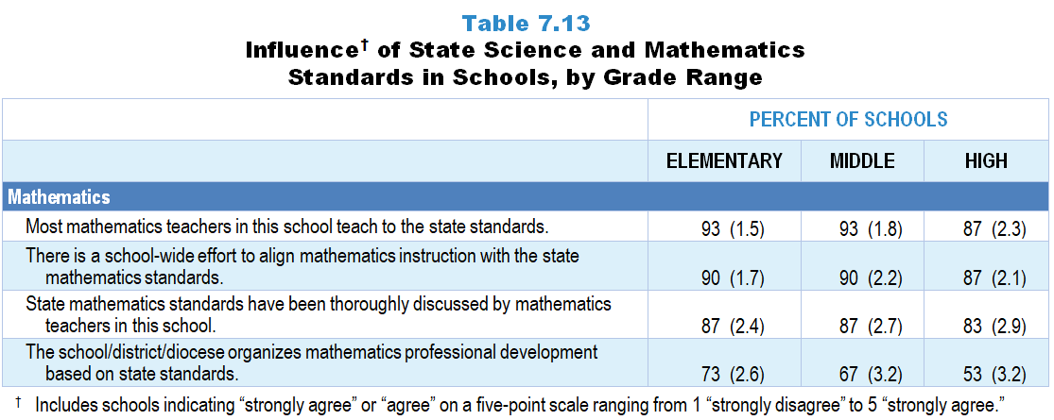
Original Data for Slides 22–24 (not for presentation)
Notes:
The mathematics portion of Table 7.13, p. 164 in Technical Report
This slide shows data from an individual item.
Mathematics Program Questionnaire
Q5. Please provide your opinion about each of the following statements in regard to your current state standards for mathematics. [Select one on each row.] (Response Options: [1] Strongly Disagree, [2] Disagree, [3] No Opinion, [4] Agree, [5] Strongly Agree)
State mathematics standards have been thoroughly discussed by mathematics teachers in this school.
There is a school-wide effort to align mathematics instruction with the state mathematics standards.
Most mathematics teachers in this school teach to the state standards.
The school/district/diocese organizes mathematics professional development based on state standards.
The numbers in parentheses are standard errors.
Findings Highlighted in Technical Report
“School science and mathematics program representatives were given a series of statements about the influence of state standards in their school and district, and asked about the extent to which they agreed with each. A summary of responses is shown in Table 7.13. It is clear that state standards have a major influence at the school level. For example, 79 percent or more of program representatives agree that teachers in the school teach to science and mathematics standards. Similarly, a large majority of representatives agree that science and mathematics standards have been thoroughly discussed by teachers in the school and that there is a school-wide effort to align instruction to standards. Both practices are especially prevalent in mathematics, with 83–90 percent of representatives agreeing across the grade levels. It is somewhat surprising that only about half of high schools are in districts that organize professional development based on science and mathematics standards.”

Slide 22
Elementary Schools Agreeing With Various Statements Regarding State Mathematics Standards
Notes:
Includes schools for which the respondent selected “strongly agree” or “agree” on a 5-point response scale with the options “strongly disagree,” “disagree,” “no opinion,” “agree,” and “strongly agree.”
Note: Each grade-level chart is sorted independently; consequently items may appear in different orders.

Slide 23
Middle Schools Agreeing With Various Statements Regarding State Mathematics Standards
Notes:
Includes schools for which the respondent selected “strongly agree” or “agree” on a 5-point response scale with the options “strongly disagree,” “disagree,” “no opinion,” “agree,” and “strongly agree.”
Note: Each grade-level chart is sorted independently; consequently items may appear in different orders.

Slide 24
High Schools Agreeing With Various Statements Regarding State Mathematics Standards
Notes:
Includes schools for which the respondent selected “strongly agree” or “agree” on a 5-point response scale with the options “strongly disagree,” “disagree,” “no opinion,” “agree,” and “strongly agree.”
Note: Each grade-level chart is sorted independently; consequently items may appear in different orders.

Slide 25
Original Data for Slide 26 (not for presentation)
Notes:
The mathematics portion of Table 7.14, p. 164 in Technical Report
This slide shows data from Composites.
Sets of related questionnaire items were combined to create several composite variables related to key constructs. Composite variables, which are more reliable than individual survey items, were computed to have a minimum possible value of 0 and a maximum possible value of 100. Higher composite scores indicate more of the construct being measure by the composite. Each composite is calculated by summing the responses to the items associated with that composite and then dividing by the total points possible. In order for the composites to be on a 100-point scale, the lowest response option on each scale was set to 0 and the others were adjusted accordingly; so for example, an item with a scale ranging from 1 to 4 was re-coded to have a scale of 0 to 3. By doing this, someone who marks the lowest point on every item in a composite receives a composite score of 0 rather than some positive number. It also assures that 50 is the true mid-point. The denominator for each composite is determined by computing the maximum possible sum of responses for a series of items and dividing by 100; e.g., a 9-item composite where each item is on a scale of 0–3 would have a denominator of 0.27. Composites values were not computed for participants who respond to fewer than two-thirds of the items that form the composite.
Focus on State Standards Composite Items
Q5a. State mathematics standards have been thoroughly discussed by mathematics teachers in this school.
Q5b. There is a school-wide effort to align mathematics instruction with the state mathematics standards.
Q5c. Most mathematics teachers in this school teach to the state standards.
Q5d. The school/district/diocese organizes mathematics professional development based on state standards.
Mathematics Program Questionnaire
Q5. Please provide your opinion about each of the following statements in regard to your current state standards for mathematics. [Select one on each row.] (Response Options: [1] Strongly Disagree, [2] Disagree, [3] No Opinion, [4] Agree, [5] Strongly Agree)
State mathematics standards have been thoroughly discussed by mathematics teachers in this school.
There is a school-wide effort to align mathematics instruction with the state mathematics standards.
Most mathematics teachers in this school teach to the state standards.
The school/district/diocese organizes mathematics professional development based on state standards.
The numbers in parentheses are standard errors.
Findings Highlighted in Technical Report
“By combining these items in a composite variable, an overview of the influence of standards is possible. As can be seen in Table 7.14, attention to standards is generally greater in mathematics than in science, particularly in elementary and middle schools. The greater weight given to mathematics in school accountability probably contributes to these results. In addition, high schools’ attention to state mathematics standards may be lower than elementary and middle schools’ because they are only held accountable in a few mathematics subjects.”

Slide 26
Focus on Mathematics State Standards Composite

Slide 27
Factors That Promote and Inhibit Effective Instruction

Slide 28
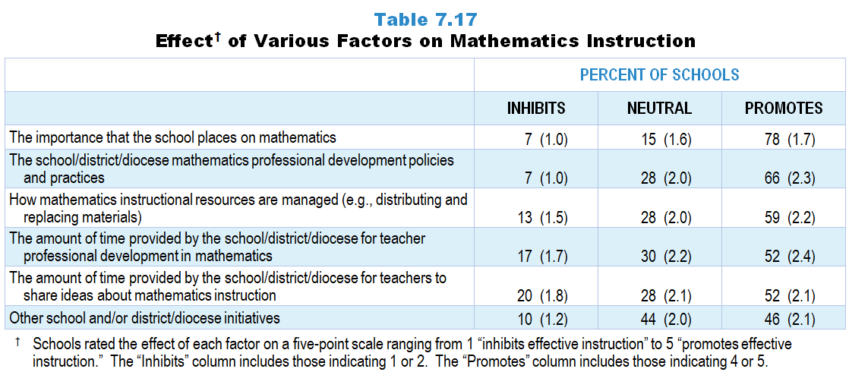
Original Data for Slides 29–30 (not for presentation)
Notes:
Table 7.17, p. 166 in Technical Report
This slide shows data from an individual item.
Mathematics Program Questionnaire
Q19. Please rate the effect of each of the following on the quality of mathematics instruction in your school. [Select one on each row.] (Response Options: [1] Inhibits effective instruction, [2] 2 of 5, [3] Neutral or mixed, [4] 4 of 5, [5] Promotes effective instruction)
The school/district/diocese mathematics professional development policies and practices
The amount of time provided by the school/district/diocese for teacher professional development in mathematics
The importance that the school places on mathematics
Other school and/or district/diocese initiatives
The amount of time provided by the school/district/diocese for teachers to share ideas about mathematics instruction
How mathematics instructional resources are managed (for example: distributing and replacing materials)
The numbers in parentheses are standard errors.
Findings Highlighted in Technical Report
“The climate for mathematics instruction seems generally more supportive than that for science. For example, 78 percent of schools indicate that the importance the school places on the subject promotes effective mathematics instruction (compared to 51 percent for science). Similarly, professional development policies and practices, as well as time provided for professional development, are more likely to be viewed as promoting effective mathematics instruction than science instruction.”

Slide 29
Schools Viewing Various Factors as Promoting Effective Mathematics Instruction
Notes:
Includes schools for which the respondent selected “inhibits effective instruction” or “2 of 5” on a 5-point response scale with the options of “inhibits effective instruction,” “2 of 5,” “neutral or mixed,” “4 of 5,” and “promotes effective instruction.”

Slide 30
Schools Viewing Various Factors as Inhibiting Effective Mathematics Instruction
Notes:
Includes schools for which the respondent selected “inhibits effective instruction” or “2 of 5” on a 5-point response scale with the options of “inhibits effective instruction,” “2 of 5,” “neutral or mixed,” “4 of 5,” and “promotes effective instruction.”

Slide 31
Original Data for Slide 32 (not for presentation)
Notes:
The mathematics portion of Table 7.18, p. 166 in Technical Report
This slide shows data from Composites.
Sets of related questionnaire items were combined to create several composite variables related to key constructs. Composite variables, which are more reliable than individual survey items, were computed to have a minimum possible value of 0 and a maximum possible value of 100. Higher composite scores indicate more of the construct being measure by the composite. Each composite is calculated by summing the responses to the items associated with that composite and then dividing by the total points possible. In order for the composites to be on a 100-point scale, the lowest response option on each scale was set to 0 and the others were adjusted accordingly; so for example, an item with a scale ranging from 1 to 4 was re-coded to have a scale of 0 to 3. By doing this, someone who marks the lowest point on every item in a composite receives a composite score of 0 rather than some positive number. It also assures that 50 is the true mid-point. The denominator for each composite is determined by computing the maximum possible sum of responses for a series of items and dividing by 100; e.g., a 9-item composite where each item is on a scale of 0–3 would have a denominator of 0.27. Composites values were not computed for participants who respond to fewer than two-thirds of the items that form the composite.
Supportive Context for Mathematics Instruction Composite
Q19a. The school/district/diocese mathematics professional development policies and practices
Q19b. The amount of time provided by the school/district/diocese for teacher professional development in mathematics
Q19c. The importance that the school places on mathematics
Q19d. Other school and/or district/diocese initiatives
Q19e. The amount of time provided by the school/district/diocese for teachers to share ideas about mathematics instruction
Q19f. How mathematics instructional resources are managed (for example: distributing and replacing materials)
Mathematics Program Questionnaire
Q19. Please rate the effect of each of the following on the quality of mathematics instruction in your school. [Select one on each row.] (Response Options: [1] Inhibits effective instruction, [2] 2 of 5, [3] Neutral or mixed, [4] 4 of 5, [5] Promotes effective instruction)
The school/district/diocese mathematics professional development policies and practices
The amount of time provided by the school/district/diocese for teacher professional development in mathematics
The importance that the school places on mathematics
Other school and/or district/diocese initiatives
The amount of time provided by the school/district/diocese for teachers to share ideas about mathematics instruction
How mathematics instructional resources are managed (for example: distributing and replacing materials)
The numbers in parentheses are standard errors.
Findings Highlighted in Technical Report
“These items were combined into a composite variable in order to look at the effects of the factors on science and mathematics instruction more holistically. As Table 7.18 displays, elementary schools generally provide a less supportive context for science instruction than middle or high schools. In addition, elementary and middle schools tend to be more supportive for mathematics teaching than science teaching.”

Slide 32
Supportive Context for Mathematics Instruction Composites

Slide 33
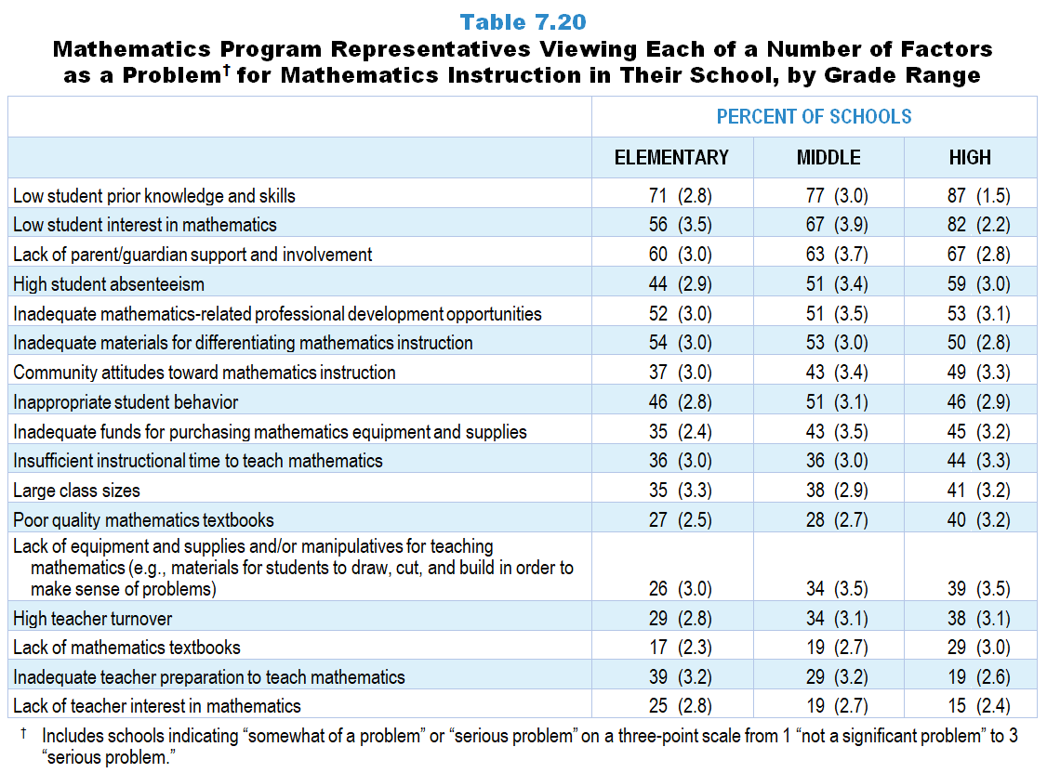
Original Data for Slides 34–42 (not for presentation)
Notes:
Table 7.20, p. 168 in Technical Report
This slide shows data from an individual item.
Mathematics Program Questionnaire
Q20. In your opinion, how great a problem is each of the following for mathematics instruction in your school as a whole? [Select one on each row.] (Response Options: [1] Not a significant problem, [2] Somewhat of a problem, [3] Serious problem)
Lack of equipment and supplies and/or manipulatives for teaching mathematics (for example: materials for students to draw, cut and build in order to make sense of problems)
Inadequate funds for purchasing mathematics equipment and supplies
Lack of mathematics textbooks
Poor quality mathematics textbooks
Inadequate materials for differentiating mathematics instruction
Low student interest in mathematics
Low student prior knowledge and skills
Lack of teacher interest in mathematics
Inadequate teacher preparation to teach mathematics
High teacher turnover
Insufficient instructional time to teach mathematics
Inadequate mathematics-related professional development opportunities
Large class sizes
High student absenteeism
Inappropriate student behavior
Lack of parent/guardian support and involvement
Community attitudes toward mathematics instruction
The numbers in parentheses are standard errors.
Findings Highlighted in Technical Report
“In mathematics, three factors are seen as a problem in a substantial proportion of schools: low student interest in the subject, low student prior knowledge and skills, and lack of parent/‌guardian support and involvement (see Table 7.20). Low student interest and low student prior knowledge are both more likely to be seen as problems in high schools than in elementary schools.”

Slide 34
Elementary Schools Viewing Each of a Number of Factors as a Problem for Mathematics Instruction in Their School
Notes:
Note: Each grade-level chart is sorted independently; consequently items may appear in different orders.
Includes schools indicating “somewhat of a problem” or “serious problem” on a three-point scale from 1 “not a significant problem” to 3 “serious problem.”

Slide 35
Elementary Schools Viewing Each of a Number of Factors as a Problem for Mathematics Instruction in Their School
Notes:
Note: Each grade-level chart is sorted independently; consequently items may appear in different orders.
Includes schools indicating “somewhat of a problem” or “serious problem” on a three-point scale from 1 “not a significant problem” to 3 “serious problem.”

Slide 36
Elementary Schools Viewing Each of a Number of Factors as a Problem for Mathematics Instruction in Their School
Notes:
Note: Each grade-level chart is sorted independently; consequently items may appear in different orders.
Includes schools indicating “somewhat of a problem” or “serious problem” on a three-point scale from 1 “not a significant problem” to 3 “serious problem.”

Slide 37
Middle Schools Viewing Each of a Number of Factors as a Problem for Mathematics Instruction in Their School
Notes:
Note: Each grade-level chart is sorted independently; consequently items may appear in different orders.
Includes schools indicating “somewhat of a problem” or “serious problem” on a three-point scale from 1 “not a significant problem” to 3 “serious problem.”

Slide 38
Middle Schools Viewing Each of a Number of Factors as a Problem for Mathematics Instruction in Their School
Notes:
Note: Each grade-level chart is sorted independently; consequently items may appear in different orders.
Includes schools indicating “somewhat of a problem” or “serious problem” on a three-point scale from 1 “not a significant problem” to 3 “serious problem.”

Slide 39
Middle Schools Viewing Each of a Number of Factors as a Problem for Mathematics Instruction in Their School
Notes:
Note: Each grade-level chart is sorted independently; consequently items may appear in different orders.
Includes schools indicating “somewhat of a problem” or “serious problem” on a three-point scale from 1 “not a significant problem” to 3 “serious problem.”

Slide 40
High Schools Viewing Each of a Number of Factors as a Problem for Mathematics Instruction in Their School
Notes:
Note: Each grade-level chart is sorted independently; consequently items may appear in different orders.
Includes schools indicating “somewhat of a problem” or “serious problem” on a three-point scale from 1 “not a significant problem” to 3 “serious problem.”

Slide 41
High Schools Viewing Each of a Number of Factors as a Problem for Mathematics Instruction in Their School
Notes:
Note: Each grade-level chart is sorted independently; consequently items may appear in different orders.
Includes schools indicating “somewhat of a problem” or “serious problem” on a three-point scale from 1 “not a significant problem” to 3 “serious problem.”

Slide 42
High Schools Viewing Each of a Number of Factors as a Problem for Mathematics Instruction in Their School
Notes:
Note: Each grade-level chart is sorted independently; consequently items may appear in different orders.
Includes schools indicating “somewhat of a problem” or “serious problem” on a three-point scale from 1 “not a significant problem” to 3 “serious problem.”

Slide 43
Original Data for Slide 44 (not for presentation)
Notes:
Table 7.21, p. 168 in Technical Report
This slide shows data from Composites.
Sets of related questionnaire items were combined to create several composite variables related to key constructs. Composite variables, which are more reliable than individual survey items, were computed to have a minimum possible value of 0 and a maximum possible value of 100. Higher composite scores indicate more of the construct being measure by the composite. Each composite is calculated by summing the responses to the items associated with that composite and then dividing by the total points possible. In order for the composites to be on a 100-point scale, the lowest response option on each scale was set to 0 and the others were adjusted accordingly; so for example, an item with a scale ranging from 1 to 4 was re-coded to have a scale of 0 to 3. By doing this, someone who marks the lowest point on every item in a composite receives a composite score of 0 rather than some positive number. It also assures that 50 is the true mid-point. The denominator for each composite is determined by computing the maximum possible sum of responses for a series of items and dividing by 100; e.g., a 9-item composite where each item is on a scale of 0–3 would have a denominator of 0.27. Composites values were not computed for participants who respond to fewer than two-thirds of the items that form the composite.
Extent to which lack of resources is problematic
Q20a. Lack of equipment and supplies and/or manipulatives for teaching mathematics (for example: materials for students to draw, cut and build in order to make sense of problems)
Q20b. Inadequate funds for purchasing mathematics equipment and supplies
Q20c. Lack of mathematics textbooks
Q20d. Poor quality mathematics textbooks
Q20e. Inadequate materials for differentiating mathematics instruction
Extent to which student issues are problematic
Q20f. Low student interest in mathematics
Q20g. Low student prior knowledge and skills
Q20n. High student absenteeism
Q20o. Inappropriate student behavior
Q20p. Lack of parent/guardian support and involvement
Q20q. Community attitudes toward mathematics instruction
Extent to which teacher issues are problematic
Q20h. Lack of teacher interest in mathematics
Q20i. Inadequate teacher preparation to teach mathematics
Q20k. Insufficient instructional time to teach mathematics
Q20l. Inadequate mathematics-related professional development opportunities
Mathematics Program Questionnaire
Q20. In your opinion, how great a problem is each of the following for mathematics instruction in your school as a whole? [Select one on each row.] (Response Options: [1] Not a significant problem, [2] Somewhat of a problem, [3] Serious problem)
Lack of equipment and supplies and/or manipulatives for teaching mathematics (for example: materials for students to draw, cut and build in order to make sense of problems)
Inadequate funds for purchasing mathematics equipment and supplies
Lack of mathematics textbooks
Poor quality mathematics textbooks
Inadequate materials for differentiating mathematics instruction
Low student interest in mathematics
Low student prior knowledge and skills
Lack of teacher interest in mathematics
Inadequate teacher preparation to teach mathematics
High teacher turnover
Insufficient instructional time to teach mathematics
Inadequate mathematics-related professional development opportunities
Large class sizes
High student absenteeism
Inappropriate student behavior
Lack of parent/guardian support and involvement
Community attitudes toward mathematics instruction
The numbers in parentheses are standard errors.
Findings Highlighted in Technical Report
“Composite variables created from these items allow for a summary of the factors affecting science and mathematics instruction. One striking difference is that the extent to which student issues are seen as problematic is more pronounced in mathematics instruction compared to science instruction (see Table 7.21). Some differences across grade ranges are also apparent, particularly in science. Specifically, lack of resources and teacher-related issues are more notable at the elementary level than at the high school level.”

Slide 44
Extent Various Factors are Problematic for Instruction Composites

Slide 45
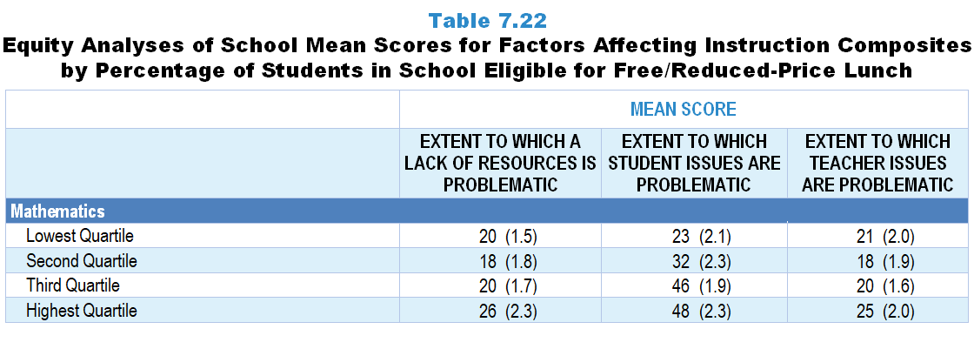
Original Data for Slide 46 (not for presentation)
Notes:
The mathematics portion of Table 7.22, p. 169 in Technical Report
This slide shows data from Composites.
Sets of related questionnaire items were combined to create several composite variables related to key constructs. Composite variables, which are more reliable than individual survey items, were computed to have a minimum possible value of 0 and a maximum possible value of 100. Higher composite scores indicate more of the construct being measure by the composite. Each composite is calculated by summing the responses to the items associated with that composite and then dividing by the total points possible. In order for the composites to be on a 100-point scale, the lowest response option on each scale was set to 0 and the others were adjusted accordingly; so for example, an item with a scale ranging from 1 to 4 was re-coded to have a scale of 0 to 3. By doing this, someone who marks the lowest point on every item in a composite receives a composite score of 0 rather than some positive number. It also assures that 50 is the true mid-point. The denominator for each composite is determined by computing the maximum possible sum of responses for a series of items and dividing by 100; e.g., a 9-item composite where each item is on a scale of 0–3 would have a denominator of 0.27. Composites values were not computed for participants who respond to fewer than two-thirds of the items that form the composite.
Extent to which lack of resources is problematic
Q20a. Lack of equipment and supplies and/or manipulatives for teaching mathematics (for example: materials for students to draw, cut and build in order to make sense of problems)
Q20b. Inadequate funds for purchasing mathematics equipment and supplies
Q20c. Lack of mathematics textbooks
Q20d. Poor quality mathematics textbooks
Q20e. Inadequate materials for differentiating mathematics instruction
Extent to which student issues are problematic
Q20f. Low student interest in mathematics
Q20g. Low student prior knowledge and skills
Q20n. High student absenteeism
Q20o. Inappropriate student behavior
Q20p. Lack of parent/guardian support and involvement
Q20q. Community attitudes toward mathematics instruction
Extent to which teacher issues are problematic
Q20h. Lack of teacher interest in mathematics
Q20i. Inadequate teacher preparation to teach mathematics
Q20k. Insufficient instructional time to teach mathematics
Q20l. Inadequate mathematics-related professional development opportunities
Mathematics Program Questionnaire
Q20. In your opinion, how great a problem is each of the following for mathematics instruction in your school as a whole? [Select one on each row.] (Response Options: [1] Not a significant problem, [2] Somewhat of a problem, [3] Serious problem)
Lack of equipment and supplies and/or manipulatives for teaching mathematics (for example: materials for students to draw, cut and build in order to make sense of problems)
Inadequate funds for purchasing mathematics equipment and supplies
Lack of mathematics textbooks
Poor quality mathematics textbooks
Inadequate materials for differentiating mathematics instruction
Low student interest in mathematics
Low student prior knowledge and skills
Lack of teacher interest in mathematics
Inadequate teacher preparation to teach mathematics
High teacher turnover
Insufficient instructional time to teach mathematics
Inadequate mathematics-related professional development opportunities
Large class sizes
High student absenteeism
Inappropriate student behavior
Lack of parent/guardian support and involvement
Community attitudes toward mathematics instruction
The numbers in parentheses are standard errors.
Chapters 2–7 in the technical report provide data on several key indicators, disaggregated by one or more equity factors: the prior achievement level of students in the class, the percentage of students from race/ethnicity groups historically underrepresented in STEM in the class, the percentage of students in the school eligible for free/reduced-price lunch (FRL), school size, community type, and region. For FRL, each school was classified into one of four categories (defined as quartiles) based on the proportion of students eligible for FRL. Similarly, each randomly selected class was classified into one of the four categories based on the proportion of students from race/ethnicity groups historically underrepresented in STEM in the class.
Findings Highlighted in Technical Report
“When disaggregated by the percentage of students eligible for free/‌reduced-price lunch, some differences in composite means emerge (see Table 7.22). The mean score for the Extent to Which Student Issues are Problematic composite, which includes items such as low student interest, high absenteeism, and inappropriate behavior, varies considerably in both science and mathematics by the percentage of students eligible for free/‌reduced-price lunch (ranging from 16 for the lowest quartile to 38 for the highest in science, and from 23 to 48 in mathematics). Though not as pronounced, similar gaps are seen in science for the Extent to Which a Lack of Resources is Problematic composite, which includes items about a lack of equipment and textbooks, and the Extent to Which Teacher Issues are Problematic composite, which includes items about teacher interest in the subject and teacher preparation to teach the subject.”

Slide 46
Factors Affecting Effective Instruction Composites, by Percentage of Students in School Eligible for FRL
Notes:
Slide shows the composite scores by quartile of percent of students eligible for free or reduced-price lunch in the school.

Slide 47
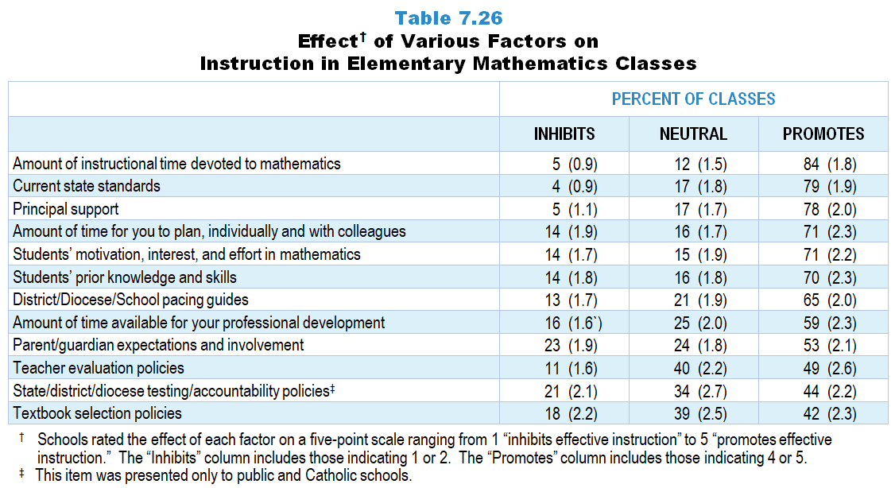
Original Data for Slides 48–49 (not for presentation)
Notes:
Table 7.26, p. 172 in Technical Report
This slide shows data from an individual item.
Mathematics Teacher Questionnaire
Q46. In your opinion, how great a problem is each of the following for mathematics instruction in your school as a whole? [Select one on each row.] (Response Options: [1] Inhibits effective instruction, [2] 2 of 5, [3] Neutral or mixed, [4] 4 of 5, [5] Promotes effective instruction, [6] N/A)
Current state standards
District/Diocese and/or school pacing guides
State/district/diocese testing/accountability policies [Not presented to non-Catholic private schools]
Textbook selection policies
Teacher evaluation policies
College entrance requirements [Presented to grades 9–12 teachers only]
Students’ prior knowledge and skills
Students’ motivation, interest, and effort in mathematics
Parent/guardian expectations and involvement
Principal support
Amount of time for you to plan, individually and with colleagues
Amount of time available for your professional development
Amount of instructional time devoted to mathematics [Presented to grades K–5 teachers only]
The numbers in parentheses are standard errors.
Findings Highlighted in Technical Report
“Table 7.26 displays the results for elementary mathematics. In stark contrast to the results about time available for elementary science instruction, the amount of time available for elementary mathematics instruction was rated as the greatest promoter of effective instruction. Students’ motivation, interest, and effort in mathematics, as well as their prior knowledge and skills, are seen as promoting mathematics instruction in 70 percent or more elementary classes.”

Slide 48
Factors Promoting Effective Instruction in Elementary Mathematics Classes
Notes:
Schools rated the effect of each factor on a five-point scale ranging from 1 “inhibits effective instruction” to 5 “promotes effective instruction.” The “Inhibits” column includes those indicating 1 or 2. The “Promotes” column includes those indicating 4 or 5.
PD is short for professional development.

Slide 49
Factors Inhibiting Effective Instruction in Elementary Mathematics Classes
Notes:
Schools rated the effect of each factor on a five-point scale ranging from 1 “inhibits effective instruction” to 5 “promotes effective instruction.” The “Inhibits” column includes those indicating 1 or 2. The “Promotes” column includes those indicating 4 or 5.
PD is short for professional development.

Slide 50
Original Data for Slides 51–52 (not for presentation)
Notes:
Table 7.27, p. 172 in Technical Report
This slide shows data from an individual item.
Mathematics Teacher Questionnaire
Q46. In your opinion, how great a problem is each of the following for mathematics instruction in your school as a whole? [Select one on each row.] (Response Options: [1] Inhibits effective instruction, [2] 2 of 5, [3] Neutral or mixed, [4] 4 of 5, [5] Promotes effective instruction, [6] N/A)
Current state standards
District/Diocese and/or school pacing guides
State/district/diocese testing/accountability policies [Not presented to non-Catholic private schools]
Textbook selection policies
Teacher evaluation policies
College entrance requirements [Presented to grades 9–12 teachers only]
Students’ prior knowledge and skills
Students’ motivation, interest, and effort in mathematics
Parent/guardian expectations and involvement
Principal support
Amount of time for you to plan, individually and with colleagues
Amount of time available for your professional development
Amount of instructional time devoted to mathematics [Presented to grades K–5 teachers only]
The numbers in parentheses are standard errors.
Findings Highlighted in Technical Report
“As in middle school science, principal support, amount of time for planning, and current state standards are all seen as the top factors for promoting instruction in middle school mathematics classes (see Table 7.27). Students’ motivation, interest, and effort in mathematics as well as parent/‌guardian expectations and involvement are seen as inhibiting instruction in more than a quarter of middle school mathematics classes.”

Slide 51
Factors Promoting Effective Instruction in Middle School Mathematics Classes
Notes:
Note: Each grade-level chart is sorted independently; consequently items may appear in different orders.
Schools rated the effect of each factor on a five-point scale ranging from 1 “inhibits effective instruction” to 5 “promotes effective instruction.” The “Inhibits” column includes those indicating 1 or 2. The “Promotes” column includes those indicating 4 or 5.
PD is short for professional development.

Slide 52
Factors Inhibiting Effective Instruction in Middle School Mathematics Classes
Notes:
Note: Each grade-level chart is sorted independently; consequently items may appear in different orders.
Schools rated the effect of each factor on a five-point scale ranging from 1 “inhibits effective instruction” to 5 “promotes effective instruction.” The “Inhibits” column includes those indicating 1 or 2. The “Promotes” column includes those indicating 4 or 5.
PD is short for professional development.

Slide 53
Original Data for Slides 54–55 (not for presentation)
Notes:
Table 7.28, p. 173 in Technical Report
This slide shows data from an individual item.
Mathematics Teacher Questionnaire
Q46. In your opinion, how great a problem is each of the following for mathematics instruction in your school as a whole? [Select one on each row.] (Response Options: [1] Inhibits effective instruction, [2] 2 of 5, [3] Neutral or mixed, [4] 4 of 5, [5] Promotes effective instruction, [6] N/A)
Current state standards
District/Diocese and/or school pacing guides
State/district/diocese testing/accountability policies [Not presented to non-Catholic private schools]
Textbook selection policies
Teacher evaluation policies
College entrance requirements [Presented to grades 9–12 teachers only]
Students’ prior knowledge and skills
Students’ motivation, interest, and effort in mathematics
Parent/guardian expectations and involvement
Principal support
Amount of time for you to plan, individually and with colleagues
Amount of time available for your professional development
Amount of instructional time devoted to mathematics [Presented to grades K–5 teachers only]
The numbers in parentheses are standard errors.
Findings Highlighted in Technical Report
“Table 7.28 shows that in high school mathematics, principal support and the amount of time for planning promote effective instruction in more than two-thirds of classes. Like with middle school mathematics, students’ motivation, interest, and effort in mathematics are the biggest inhibitors of instruction in high school mathematics classes. College entrance requirements are seen as promoting or have a neutral effect on high school mathematics instruction in nearly all classes.”

Slide 54
Factors Promoting Effective Instruction in High School Mathematics Classes
Notes:
Note: Each grade-level chart is sorted independently; consequently items may appear in different orders.
Schools rated the effect of each factor on a five-point scale ranging from 1 “inhibits effective instruction” to 5 “promotes effective instruction.” The “Inhibits” column includes those indicating 1 or 2. The “Promotes” column includes those indicating 4 or 5.
PD is short for professional development.

Slide 55
Factors Inhibiting Effective Instruction in High School Mathematics Classes
Notes:
Note: Each grade-level chart is sorted independently; consequently items may appear in different orders.
Schools rated the effect of each factor on a five-point scale ranging from 1 “inhibits effective instruction” to 5 “promotes effective instruction.” The “Inhibits” column includes those indicating 1 or 2. The “Promotes” column includes those indicating 4 or 5.
PD is short for professional development.

Slide 56
Original Data for Slide 57 (not for presentation)
Notes:
The mathematics portion of Table 7.30, p. 174 in Technical Report
This slide shows data from Composites.
Sets of related questionnaire items were combined to create several composite variables related to key constructs. Composite variables, which are more reliable than individual survey items, were computed to have a minimum possible value of 0 and a maximum possible value of 100. Higher composite scores indicate more of the construct being measure by the composite. Each composite is calculated by summing the responses to the items associated with that composite and then dividing by the total points possible. In order for the composites to be on a 100-point scale, the lowest response option on each scale was set to 0 and the others were adjusted accordingly; so for example, an item with a scale ranging from 1 to 4 was re-coded to have a scale of 0 to 3. By doing this, someone who marks the lowest point on every item in a composite receives a composite score of 0 rather than some positive number. It also assures that 50 is the true mid-point. The denominator for each composite is determined by computing the maximum possible sum of responses for a series of items and dividing by 100; e.g., a 9-item composite where each item is on a scale of 0–3 would have a denominator of 0.27. Composites values were not computed for participants who respond to fewer than two-thirds of the items that form the composite.
Extent to which lack of resources is problematic
Q46a. Current state standards
Q46b. District/Diocese and/or school pacing guides
Q46c. State/district/diocese testing/accountability policies [Not presented to non-Catholic private schools]
Q46d. Textbook selection policies
Q46e. Teacher evaluation policies
Extent to which student issues are problematic
Q46g. Students’ prior knowledge and skills
Q46h. Students’ motivation, interest, and effort in mathematics
Q46i. Parent/guardian expectations and involvement
Extent to which teacher issues are problematic
Q46k. Amount of time for you to plan, individually and with colleagues
Q46l. Amount of time available for your professional development
Mathematics Teacher Questionnaire
Q46. In your opinion, how great a problem is each of the following for mathematics instruction in your school as a whole? [Select one on each row.] (Response Options: [1] Inhibits effective instruction, [2] 2 of 5, [3] Neutral or mixed, [4] 4 of 5, [5] Promotes effective instruction, [6] N/A)
Current state standards
District/Diocese and/or school pacing guides
State/district/diocese testing/accountability policies [Not presented to non-Catholic private schools]
Textbook selection policies
Teacher evaluation policies
College entrance requirements [Presented to grades 9–12 teachers only]
Students’ prior knowledge and skills
Students’ motivation, interest, and effort in mathematics
Parent/guardian expectations and involvement
Principal support
Amount of time for you to plan, individually and with colleagues
Amount of time available for your professional development
Amount of instructional time devoted to mathematics [Presented to grades K–5 teachers only]
The numbers in parentheses are standard errors.
Findings Highlighted in Technical Report
“Composites from these teacher questionnaire items were created to summarize the extent to which various factors support effective science and mathematics instruction. The means for each subject and grade range are shown in Table 7.30. Several patterns are apparent in the results. The extent to which the policy environment promotes effective instruction is about the same across grade levels in science. Similarly, the extent to which school support promotes effective instruction varies little across grade levels in mathematics. In addition, stakeholders are seen to be the most supportive in the elementary grades for both science and mathematics. Finally, in high school computer science, school and stakeholder support is generally high (mean scores of 74 and 70, respectively) compared with the policy environment (mean score of 59).”

Slide 57
Factors Promoting Effective Mathematics Instruction Composites

Slide 58
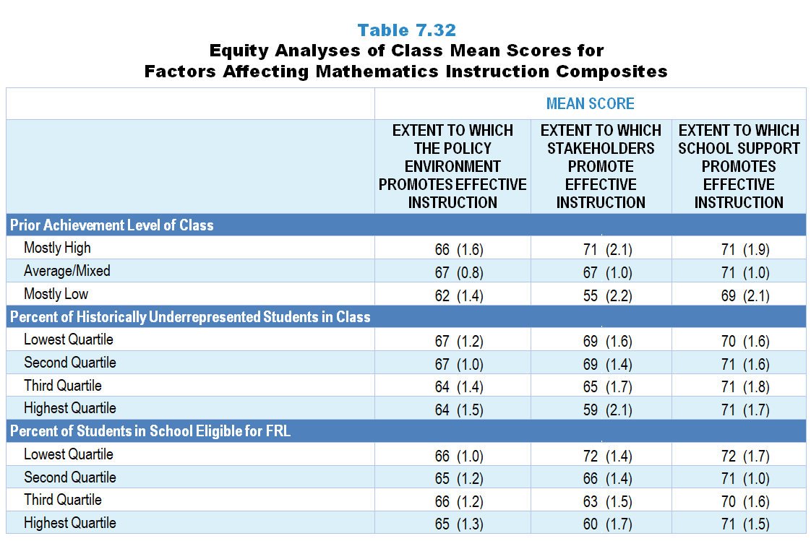
Original Data for Slides 59–60 (not for presentation)
Notes:
Table 7.32, p. 175 in Technical Report
This slide shows data from Composites.
Sets of related questionnaire items were combined to create several composite variables related to key constructs. Composite variables, which are more reliable than individual survey items, were computed to have a minimum possible value of 0 and a maximum possible value of 100. Higher composite scores indicate more of the construct being measure by the composite. Each composite is calculated by summing the responses to the items associated with that composite and then dividing by the total points possible. In order for the composites to be on a 100-point scale, the lowest response option on each scale was set to 0 and the others were adjusted accordingly; so for example, an item with a scale ranging from 1 to 4 was re-coded to have a scale of 0 to 3. By doing this, someone who marks the lowest point on every item in a composite receives a composite score of 0 rather than some positive number. It also assures that 50 is the true mid-point. The denominator for each composite is determined by computing the maximum possible sum of responses for a series of items and dividing by 100; e.g., a 9-item composite where each item is on a scale of 0–3 would have a denominator of 0.27. Composites values were not computed for participants who respond to fewer than two-thirds of the items that form the composite.
Extent to which lack of resources is problematic
Q46a. Current state standards
Q46b. District/Diocese and/or school pacing guides
Q46c. State/district/diocese testing/accountability policies [Not presented to non-Catholic private schools]
Q46d. Textbook selection policies
Q46e. Teacher evaluation policies
Extent to which student issues are problematic
Q46g. Students’ prior knowledge and skills
Q46h. Students’ motivation, interest, and effort in mathematics
Q46i. Parent/guardian expectations and involvement
Extent to which teacher issues are problematic
Q46k. Amount of time for you to plan, individually and with colleagues
Q46l. Amount of time available for your professional development
Mathematics Teacher Questionnaire
Q30. For the number of students in this class, indicate the number of males and females in each of the following categories of race/ethnicity.
American Indian or Alaskan Native _____ _____
Asian _____ _____
Black or African American _____ _____
Hispanic or Latino _____ _____
Native Hawaiian or Other Pacific Islander _____ _____
White _____ _____
Two or more races _____ _____
Q31. Which of the following best describes the prior mathematics achievement levels of the students in this class relative to other students in this school?
Mostly low achievers
Mostly average achievers
Mostly high achievers
A mixture of levels
Q46. In your opinion, how great a problem is each of the following for mathematics instruction in your school as a whole? [Select one on each row.] (Response Options: [1] Inhibits effective instruction, [2] 2 of 5, [3] Neutral or mixed, [4] 4 of 5, [5] Promotes effective instruction, [6] N/A)
Current state standards
District/Diocese and/or school pacing guides
State/district/diocese testing/accountability policies [Not presented to non-Catholic private schools]
Textbook selection policies
Teacher evaluation policies
College entrance requirements [Presented to grades 9–12 teachers only]
Students’ prior knowledge and skills
Students’ motivation, interest, and effort in mathematics
Parent/guardian expectations and involvement
Principal support
Amount of time for you to plan, individually and with colleagues
Amount of time available for your professional development
Amount of instructional time devoted to mathematics [Presented to grades K–5 teachers only]
The numbers in parentheses are standard errors.
Chapters 2–7 in the technical report provide data on several key indicators, disaggregated by one or more equity factors: the prior achievement level of students in the class, the percentage of students from race/ethnicity groups historically underrepresented in STEM in the class, the percentage of students in the school eligible for free/reduced-price lunch (FRL), school size, community type, and region. For FRL, each school was classified into one of four categories (defined as quartiles) based on the proportion of students eligible for FRL. Similarly, each randomly selected class was classified into one of the four categories based on the proportion of students from race/ethnicity groups historically underrepresented in STEM in the class.
Findings Highlighted in Technical Report
“The means for some of these factors vary substantially by equity factors. As can be seen in Tables 7.31‒7.33, the mean for the stakeholder composite is substantially higher when classes are composed of mostly high-achieving students, compared to classes with mostly low-achieving students in both science and mathematics. There is also a large gap for this variable in both subjects with regard to poverty—classes in schools with a high percentage of students eligible for free/‌reduced-price lunch have lower scores than classes in schools with the lowest percentage of these students. These patterns do not tend to exist in computer science, perhaps because far fewer schools offer computer science programs.”

Slide 59
Class Mean Scores for Factors Promoting Effective Mathematics Instruction Composites, by Prior Achievement Level

Slide 60
Factors Promoting Effective Mathematics Instruction Composites, by Percentage of Students in School Eligible for FRL
Notes:
Slide shows the composite scores by quartile of percent of students eligible for free or reduced-price lunch in the school.

